Slide 1

Logistics outsourcing overview
USAID GLOBAL HEALTH SUPPLY CHAIN PROGRAM
Procurement and Supply Management
February 2024
Confidentiality Disclaimer: This contains confidential and sensitive information. This presentation is intended primarily for GHSC-PSM and USAID audiences. While the information included herein is believed to be accurate and reliable at the time of sharing, GHSC-PSM does not make any guarantees as to the accuracy and completeness of the included information. Recipients should not distribute or duplicate parts or the whole of this presentation without written permission from USAID.

Slide 2
Outline
Overview
Outsourcing data inputs
Methodology
Key findings: outsourcing warehousing and distribution (W&D) services
Summary
Contact information

Slide 3


Overview
The USAID Global Health Supply Chain Program-Procurement and Supply Management (GHSC-PSM) project conducted an analysis¹ to better understand where governments and parastatals are outsourcing warehousing and distribution (W&D) services, through government funding or holding contracts with private sector entities for health logistics services.
The data collected informs global stakeholders and national entities about health supply chain services being outsourced by governments and parastatal organizations; this information supports technical and programmatic decision-making regarding public health supply chains.
¹ The Office of HIV/AIDS and Population and Reproductive Health funded the assessment, but all health areas were incorporated/considered within the analysis.

Slide 4




Outsourcing data inputs
  Data includes:
  Where country governments and parastatals are outsourcing warehousing and distribution services.
  The analysis considered outsourcing where either the government or parastatals funded the services or held the contracts with private sector service providers.
  Fiscal Year 2022 or calendar year 2022 data
  All relevant health/disease areas
  Supply chain level(s) where outsourcing is taking place

Slide 5
Methodology
Data Disclaimer: Some of the information may not be up to date, may be missing in some cases, and may not be completely accurate as validation was limited to the data that the project was able to obtain from in-country counterparts and government officials.
  Scope
  Data Collection
  Data analysis/Validation
  Selected 42 countries based on GHSC-PSM’s presence and local contract engagements. Countries included: Angola, Benin, Botswana, Burkina Faso, Burundi, Cambodia, Cameroon, Colombia, Cote D’Ivoire, Democratic Republic of the Congo, Eswatini, Ethiopia, Ghana, Guinea, Indonesia, Kenya, Kyrgyzstan, Lesotho, Liberia, Madagascar, Malawi, Mali, Mozambique, Myanmar, Namibia, Nepal, Nigeria, Pakistan, Panama, Philippines, Laos, Thailand, Rwanda, Senegal, Sierra Leone, South Sudan, Sudan*, Tanzania, Uganda, Vietnam, Zambia, and Zimbabwe.
Developed questions in coordination with USAID to assess government and parastatal outsourcing efforts at the central, sub-national, and facility level.
Once the data was circulated, GHSC-PSM established deadlines and engaged in ongoing follow up with GHSC-PSM countries to obtain pending data or clarify input as needed. Project office POCs (e.g., logistics specialists, commodity procurement managers) were responsible for obtaining data from in-country counterparts and government officials as relevant.
Where an NFO project was in place, the data collected was primarily facilitated through other Chemonics presence projects.
GHSC-PSM validated the data by supply chain level to verify that information was complete and concise.
The review included ensuring that when an affirmative response was provided, all associated responses were also provided (i.e., if contracted services are being engaged, then inputs for private sector entity names, # of warehouses involved, level to which distribution occurs, etc. were all indicated).
GHSC-PSM posted a request to International Association of Public Health Logisticians (IAPHL), asking members to share details of countries where governments and/or parastatals may be outsourcing supply chain services. Based on the responses received, GHSC-PSM reached out to project offices to follow up on the details provided.
*The GHSC-PSM project does not have a presence in Sudan nor a Non-Field Office (NFO) project.

Slide 6

Key findings: outsourcing W&D services.

Slide 7

Findings: government & parastatal outsourcing
  Botswana
  Indonesia
  Kenya
  Malawi
  Mozambique
  Myanmar
  Nepal
  Pakistan
  Sudan*
  *The GHSC-PSM project does not have a presence in Sudan nor a Non-Field Office (NFO) project.
Of 42 countries surveyed, governments or parastatals in 9 countries were found to be outsourcing W&D services.

Slide 8
Botswana
Key Elements | Findings
Health/disease area | HIV
Contracting agency | Government of Botswana
Funding agent / agency(ies) funding outsourcing | Government of Botswana
Private sector entity | BotswanaPost, a government parastatal which won a competitive solicitation to provide these services.
Description of Services Outsourced | Central level WH storage services and distribution to the sub-national WH level and the facility level are outsourced to BotswanaPost. The parastatal delivers to roughly 20% of the total number of health facilities.

Slide 9
Indonesia
Key Elements | Findings
Health area / disease area | HIV
Contracting agency | Government of the Republic of Indonesia
Funding agent / agencies(ies) funding outsourcing | Central level WH: Global Fund Distribution to the sub-national WH: National AIDS Program (NAP) and the Directorate of Pharmaceuticals (Binfar) under the Ministry of Health (MOH).
Private sector entity (if applicable) | PT Caraka Jaya Sentosa
Description of Services Outsourced | Central level WH storage services and distribution to the sub-national WH level by PT Caraka Jaya Sentosa.

Slide 10
Kenya
Key Elements | Findings
Health area / disease area | HIV, Malaria Nets, Malaria Pharma, and FP
Contracting agency | Kenya Medical Supplies Authority (KEMSA)
Funding agent / agencies(ies) funding outsourcing | KEMSA uses fees charged on the procuring agents/donors (Global Fund, UNFPA, CHAI).
Private sector entity (if applicable) | Various private sector entities won competitive solicitations. These entities include Posta Courier, BM Courier Services, and Sai Cargo.
Description of Services Outsourced | Distribution services to the facility level by Posta Courier, BM Courier Services, and Sai Cargo.

Slide 11
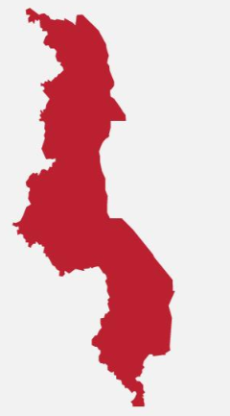
Malawi
Key Elements | Findings
Health area / disease area | HIV, Malaria Pharma, FP, MNCH
Contracting agency | Government of Malawi and Central Medical Stores Trust (CMST)
Funding agent / agencies(ies) funding outsourcing | Central WH and Facility level: Global Fund Facility level: CMST
Private sector entity (if applicable) | Bollore through the Global Fund and Cargo Management Logistics through CMST
Description of Services Outsourced | Central level WH storage services and distribution to the facility level by Bollore. Distribution to the facility level by Cargo Management Logistics.

Slide 12
Mozambique
Key Elements | Findings
Health area / disease area | HIV, Malaria Pharma, FP, MNCH
Contracting agency | Republic of Mozambique
Funding agent / agencies(ies) funding outsourcing | Government of the Republic of Mozambique
Private sector entity (if applicable) | Various private sector entities won competitive solicitations. These entities include, Found Life Lda, Line Cargo, Auttrack, and TCO.
Description of Services Outsourced | Distribution to the sub-national WH level by Found Life Lda, Line Cargo, Auttrack, and TCO.

Slide 13
Myanmar
Key Elements | Findings
Health area / disease area | HIV, Malaria Nets and Malaria Pharma
Contracting agency | Republic of the Union of Myanmar
Funding agent / agencies(ies) funding outsourcing | Global Fund
Private sector entity (if applicable) | Grand Fortuna Co. Ltd
Description of Services Outsourced | Distribution to the sub-national WH level by Grand Fortuna Co. Ltd

Slide 14
Nepal
Key Elements | Findings
Health area / disease area | FP and MNCH
Contracting agency | Government of Nepal
Funding agent / agencies(ies) funding outsourcing | Government of Nepal
Private sector entity (if applicable) | Awarded to a private sector entity through competitive solicitation.
Description of Services Outsourced | Distribution to the sub-national WH level.

Slide 15
Pakistan
Key Elements | Findings
Health area / disease area | TB and Malaria Nets
Contracting agency | Government of Pakistan
Funding agent / agencies(ies) funding outsourcing | Global Fund
Private sector entity (if applicable) | TB: International Air Cargo; Malaria Nets: MERF
Description of Services Outsourced | Sub-national WH storage services by International Air Cargo and MERF

Slide 16
Summary
Out of the 42 countries surveyed, only 9 countries were found to be outsourcing W&D services through either governments or parastatals holding the contract with the private sector or funding the services.
This calls for an in-depth analysis aimed at informing governments on the benefits and challenges posed by outsourcing W&D services.
Advocacy efforts on this topic can provide governments with the relevant information to support decision-making on outsourcing of W&D services to the private sector.

Slide 17
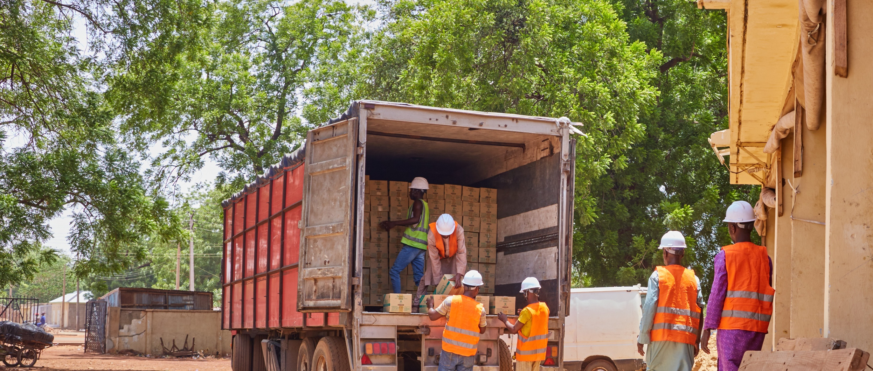
USAID GLOBAL HEALTH SUPPLY CHAIN PROGRAM-Procurement and Supply Management
Jessicah Zulu, jzulu@ghsc-psm.org
Carina Ahuja, cahuja@chemonics.com
Jaya Chimnani, jchimnani@ghsc-psm.org
The USAID Global Health Supply Chain Program-Procurement and Supply Management (GHSC-PSM) project is funded under USAID Contract No. AID-OAA-I-15-0004. GHSC-PSM connects technical solutions and proven commercial processes to promote efficient and cost-effective health supply chains worldwide. Our goal is to ensure uninterrupted supplies of health commodities to save lives and create a healthier future for all. The project purchases and delivers health commodities, offers comprehensive technical assistance to strengthen national supply chain systems, and provides global supply chain leadership. For more information, visit ghsupplychain.org.
The views expressed in this presentation do not necessarily reflect the views of USAID or the U.S. government.

