Slide 1
Rwanda Digital Health and Traceability Implementation
Peter ISHIMWE, B. Pharm Commodity Security Advisor, GHSC-PSM
Photo: Lan Andrian

Slide 2
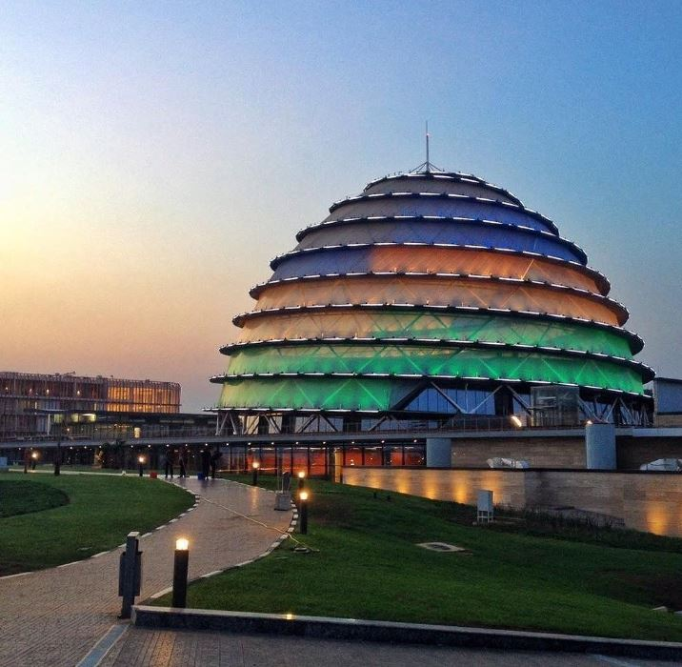
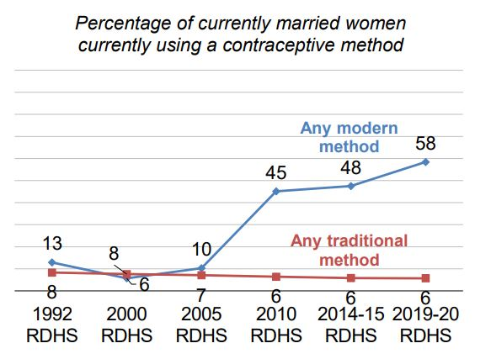
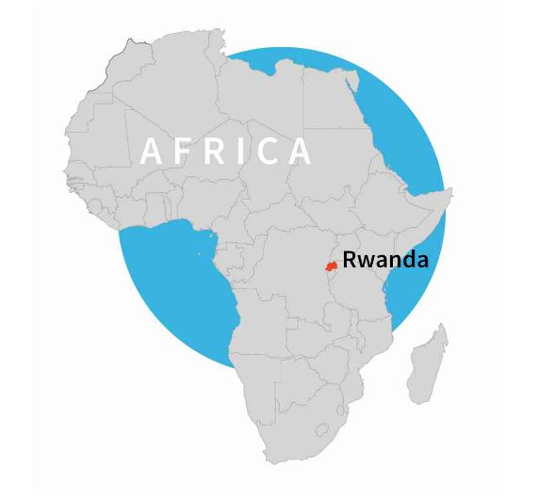
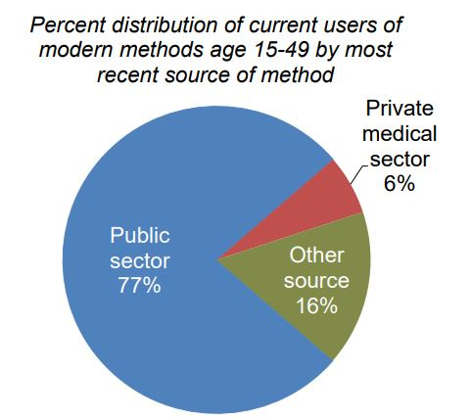
Family Planning in Rwanda
Language: Kinyarwanda, English, French, Swahili
Population: 12.9 million
Women 15 - 49: 63.1%
Life expectancy: 68 for women, 65 for men
Women in Parliament: 61%
Wanted births: The wanted fertility rate is 3.1, while the total fertility rate is 4.1. This suggests that Rwandan women are currently having, on average, one more child than they want.
https://dhsprogram.com/pubs/pdf/FR370/FR370.pdf
Notes:
- Current contraceptive use: Modern contraceptive use is higher among currently married women (58%) than among sexually active unmarried women (48%). The contraceptive prevalence rate for any method is 64% among currently married women.
- Contraceptive discontinuation: About a third of women (30%) who began using a contraceptive method in the 5 years preceding the survey discontinued the method within 12 months. The most common reason for discontinuation was side effects/health concerns (30%).
- Demand for family planning: The total demand for family planning among currently married women is 78%; 75% of total demand is satisfied by modern methods.
- Unmet need for family planning: Unmet need for family planning is higher among sexually active unmarried women (37%) than among currently married women (14%).
- Future use of contraception: 61% of currently married women who are not using contraception intend to use family planning in the future.
- Wanted births: The wanted fertility rate is 3.1, while the total fertility rate is 4.1. This suggests that Rwandan women are currently having, on average, one more child than they want.

Slide 3
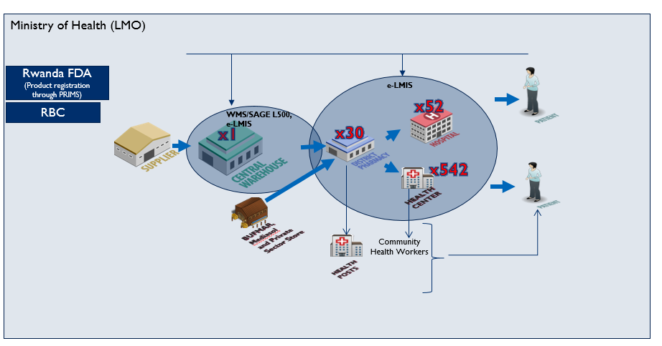
Rwanda Value Chain
In Rwanda, family planning services are provided through eight national referral hospitals (including teaching hospitals), four provincial referral hospitals, 39 district hospitals, 542 health centers, 670 health posts, and 58,567 community health workers (CHWs) operating in 14,873 villages.

Slide 4
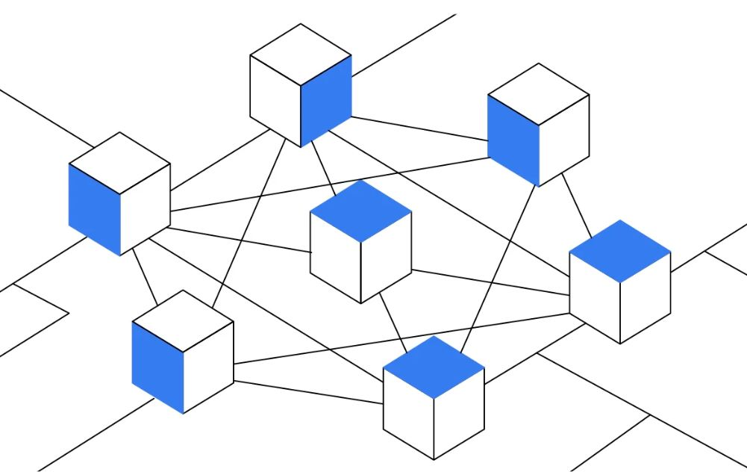
Rwanda Digital Health
Rwanda has made many gains in information communications technology (ICT) infrastructure over the past few years.
These include automation of systems that are utilized at many levels of the country’s public health supply chain (WMS, e-LMIS, HIMS, RapidSMS, EMR) and incorporate an innovative mix of paper-based and technological solutions.
While these health information systems have improved in efficiency, there are still gaps to close in the supply chain that impact interoperability, data analytics, end-to-end data visibility, product verification, and traceability.
Interoperability

Slide 5
Rwanda’s MIS Landscape
MIS Summary
System Name | Type | Notes
DHIS2 | Health Management Information System (HMIS) | Captures data on disease morbidity and mortality, maternal and child health services, service delivery, surveillance. Data collection is conducted at the health facility level using a paper-based system and aggregated data for monthly reporting and entry done at health facility level, District and national level can review the aggregated data.
Pipeline | Supply Planning | Supply planning tool
Quantimed | Forecasting | Forecasting tool
Sage 500 | Warehouse Management System (WMS) | Software managing the warehouse transactions for central medical store; integrated with e-LMIS for better collaboration with District pharmacy on order management. Order process is automated. Shares inventory status to e-LMIS user through integration.
One Network/eLMIS | eLMIS | Enterprise resource planning (ERP) tool; captures all inventory management (managing, requisition or order processing), warehouse execution at District pharmacy and health facility level, transportation of shipment, invoicing, and inventory management indicator reporting. Provides real time information and end to end visibility.
RAPIDSMS | Rapid SMS | Captures new cases in the community level on daily basis. The CHW are reporting using SMS through the phone and the report are accessed on web at central level.
QAT | QAT | Tool rolled out last year and not yet full utilized.
DHIS2
E-LMIS
RapidSMS
Central
Quantimed
Pipeline
DHIS2
Monitoring and reporting
Automation/Order processing and collaboration between CWS and District Pharmacies
Sage 500
Review reported cases and take action
QAT
District
DHIS2
There is no data entry at District level. District has access to the report from SDPs in the catchment area
One Network (Automation and data entry)
Managing warehouse execution and requisition
Review reported cases and take action
Facility
Data entered on HMIS platform on reporting period and data view at District level and central level
One Network
(Automation & Data Entry)
Health Facility record daily consumption
Review reported cases and take action
CHW
Report consumption using paper base tool
Data entry using mobile phone
Key:
Arrow:
Web-based
Standalone
Process action
Commodity flow
Data Flow

Slide 6
Journey To Today
MoH in collaboration with USAID Global Health Supply Chain Program-Procurement and Supply Management (GHSC-PSM) project conducted a holistic supply chain information systems maturity assessment in 2019 using the Supply Chain Information System Maturity Model (SCISMM).
The assessment found gaps and challenges with master data management, especially product master data management, which is foundational to supply chain information systems.
This led to the planning, development, and implementation of National Product Catalog and its mobile application.
The assessment also indicated a need for monitoring family planning shipments from different implementing partners. This led to the adoption of the Global Family Planning Visibility Analytics Network (VAN).

Slide 7
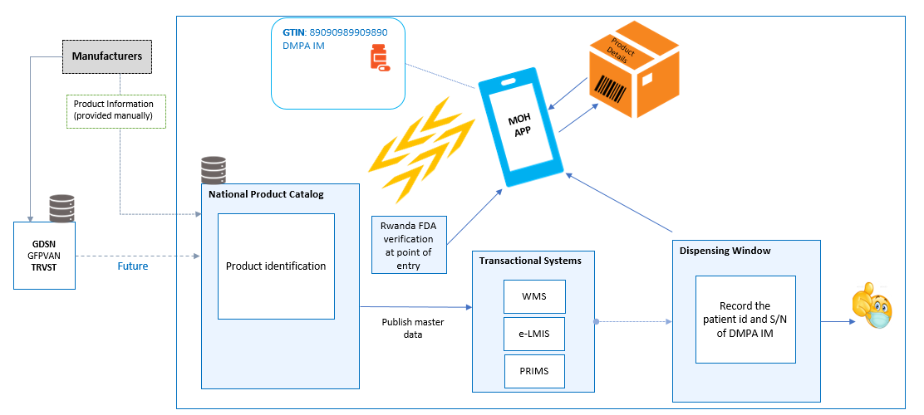
Rwanda Product Verification Architecture
Notes:
NPC is a single source of truth for health community products. NPC can get information from Manufactures through Rwanda FDA, it will in future get information from other repositories such as GDSN/TRST. NPC Mobile Application here is used by Rwanda FDA at point of entry to scan and verify authenticity of the product using GTIN. Transactional systems can consume data from NPC, the Mobile Application can also be used at the dispensing window for authentication of the product dispensed.

Slide 8
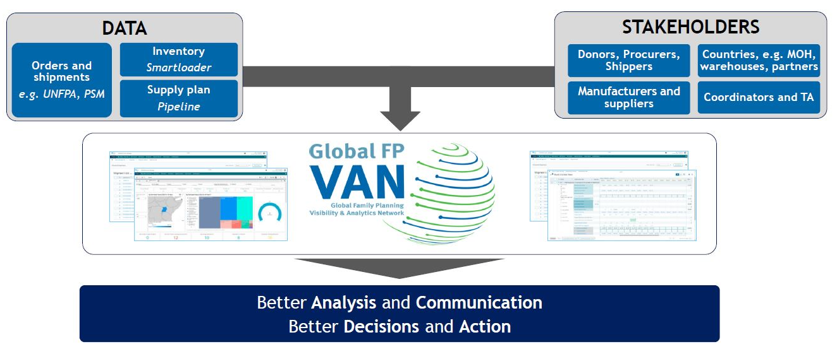
GFPVAN
True visibility into the FP supply chain requires linking global and country actors so all are able to access the same information, enabling more robust decision-making.
Countries can select from three membership options: Basic, Premium and Premium+. Rwanda has been on Basic membership since 2021 and will be upgrading to Premium membership next year.
Notes:
The VAN has been used to support collaborative supply planning with donors and manufacturers by enabling communication more directly with global-level partners to increase visibility of Rwanda’s requirements/needs. From 2021 to-date, the VAN’s Consensus Planning Group helped to:
- Expedite 75,096 units of Implanon NXT
- Flag urgent needs for UNFPA Supplies’ consideration for their 2nd tranche of funding. Resulted in new requisitions from UNFPA valued at ~$134,282.
Rwanda MoH ‘s next step is to upgrade to the Premium memebership. Country members will able to utilize the VAN to:
- Track orders and shipments coming into the country (updated daily), mapped against the country’s existing inventory and supply plan data.
- Monitor and update supply plans via daily updates to orders and shipments.
- Access Control Tower support to help right-size supply plans and identify and resolve data validation and exceptions management needs.
- Submit and monitor exceptions, enabling rapid response to avoid stockouts.
- Review current and projected stock outlooks with trading partners via a collaborative dashboard, allowing for efficient planning and problem-solving.
- Conduct joint supply planning with non-governmental trading partners, including select suppliers, donors, and social marketing organizations.

Slide 9
Achievements
Data
1. More than 60 GTINs along with standardized data collected (only Family Planning)
2. GTINs mapped to national product identifiers
3. Data harmonization and cleaning processes established
4. NPC holds more than 3500 products (All health areas)
Technology
1. NPC system developed and rolled out, using open-source tool Product Catalog Management Tool (PCMT)
2. NPC mobile application for point of entry and dispense verification rolled out
3. QAT and GFPVAN implemented
4. eLMIS being enhanced to include RMS WMS functionalities
People and process
1. Comprehensive SOPs developed to standardize product master data management processes
2. Established master data guidelines and policies to ensure sustainable sourcing of standardized master data from manufacturers
3. GS1 compliance monitoring framework under development

Slide 10
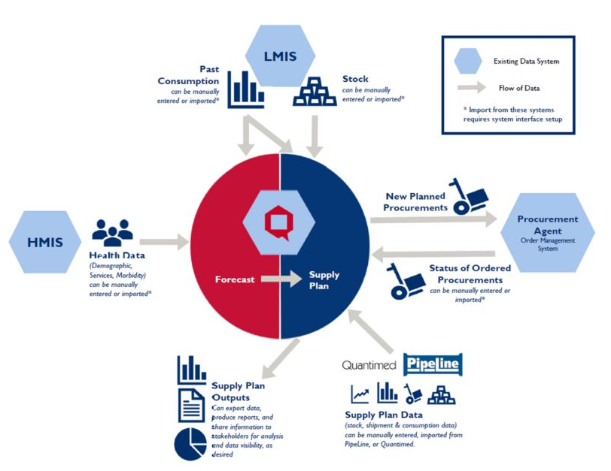
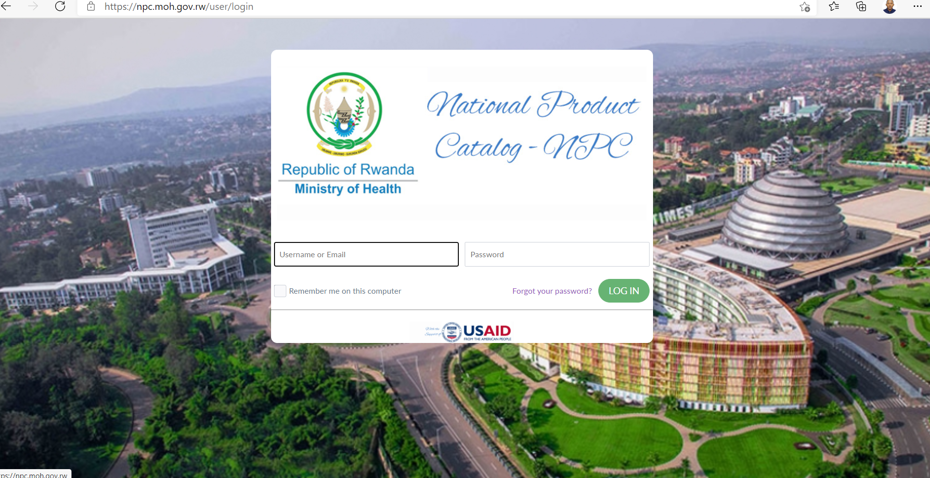
Con’t
A graphic showcasing how the Quantification Analytics Tool works
The landing page of the Rwanda National Product Catalog NPC

Slide 11
Architecture Proposed for Traceability

Slide 12
Digital Supply Chain Ecosystem Architecture

Slide 13

Summary
NPC is now single source of truth for all health commodities including contraceptives
NPC mobile application is used to verify product GTIN at the point of entry and point of dispensing to ensure the commodity safety
GFPVAN supports FP programming by providing E2E data visibility to inform decision making

Slide 14
THANK YOU !
Peter ISHIMWE, B. Pharm Email: pishimwe@ghsc-psm.org Commodity Security Advisor, USAID GHSC-PSM

