Slide 1
Panel Presentation: Innovations in Contraceptive Packaging to Drive Supply Chain Efficiencies and Commodity Security
International Conference on Family Planning 2022
PATTAYA CITY, THAILAND

Slide 2
Panelists
Ayman Abdelmohsen UNFPA
Jens Rasmussen Missionpharma
Ashley Smith USAID
Morgan Simon GHSC-PSM
Facilitator
How Contraceptive Packaging Impacts Supply Chains and Product Availability
The Path to Greener Donor Procurements through Contraceptive Packaging Improvements
Supplier Efficiencies Generated by Packaging Harmonization of Medroxyprogesterone Acetate (MPA-IM) Injectable Contraceptive
Notes:
Ayman: Ayman Abdelmohsen is a medical doctor, OB/GYN and public health specialist with almost 30 years of international professional experience in family planning, reproductive health, health care management and service delivery. Ayman works as Program Leader for UNFPA Supplies Partnership at the United Nations Population Fund (UNFPA).
Ashley: Ashley Smith works as Senior Strategic Procurement Advisor in USAID’s Global Health Bureau at the Office of Population and Reproductive Health, Commodity Security and Logistics Division. Ashley has worked with USAID since 2013, with supply chain leadership roles in Rwanda and Tanzania, and in USAID’s Office of HIV and AIDS.
Morgan: The USAID Global Health Supply Chain Program-Procurement and Supply Management (GHSC-PSM) project purchases and delivers health commodities, strengthens national supply chain systems, and provides global supply chain leadership to ensure lifesaving health supplies reach those in need, when they need them. Morgan Simon works as the FP/RH Strategic Sourcing and Market Dynamics Lead. She has worked with GHSC-PSM since 2017.
Jens: Missionpharma represents the industry of pharmaceuticals in today’s panel. Missionpharma is one of several companies holding a UNFPA and USAID contract for the supply of medroxyprogesterone acetate (MPA). Jens Rasmussen is currently working at Missionpharma as Director of the DMPA Segment and has been working with MPA for more than 10 years. Missionpharma has been working with UNFPA since 2018 and USAID since 2004.
UNFPA and USAID collaborate in several programmatic and technical initiatives related to family planning and reproductive health. The collaboration focuses in areas such as gender; population and development data; youth; total market approach; commodity security; and high-impact practices. USAID and UNFPA deliver over $200 million in contraceptives and condoms to over 30 countries annually.
UNFPA and USAID collaborate in several programmatic and technical initiatives related to family planning and reproductive health. The collaboration focuses in areas such as gender; population and development data; youth; total market approach; commodity security; and high-impact practices
UNFPA and USAID, through GHSC-PSM, are two of the largest procurers in the public sector of sexual and reproductive health commodities worldwide. We have been working together to align in different areas to become more efficient, innovative, and sustainable. Missionpharma represents the pharmaceutical industry in today’s panel and one of the multiple suppliers working with us.
In 2018, USAID, UNFPA, and GHSC-PSM began a collaborative study to revise the impact of all contraceptive packaging used in our programs and missions including condoms, injectable contraceptives, orals, IUDs, implants and pills. We exchanged information and documentation and conducted interviews with different stakeholders at the field level and with suppliers. We realized there was space for improvement (that wouldn’t impact product quality!) and a need to align packaging for all our contraceptives.
When looking at the procurement volumes and USD spend, we decided to start the project with Medroxyprogesterone Acetate - Intramuscular (MPA-IM) as the packaging is different among procurers though suppliers and beneficiaries are the same. The goal is to expand the scope of our work to all contraceptive methods.
In the scope of Medroxy example, packaging considerations include: 1) harmonization of the number of cardboard layers to reduce unnecessary cardboard usage; 2) removal of plastic straps and Styrofoam lining to facilitate recycling; 3) removal of donor logos to increase product fungibility, reduce lead-times and environmental waste, and potentially drive cost savings; and 4) bundling of MPA-IM vials and syringes in innovative new packaging to facilitate in-country distribution.
In the upcoming hour and a half, we seek to define secondary and tertiary packaging of family planning commodities and highlight the important role packaging can play to drive supply chain efficiencies, enhance commodity security, maintain affordable prices in a changing environment and reduce environmental waste.

Slide 3
How Contraceptive Packaging Impacts Supply Chains and Product Availability
Ashley Smith, Senior Strategic Procurement Advisor
Global Health Bureau, Office of Population and Reproductive Health, Commodity Security and Logistics Division

Slide 4
Outline
Introduction
Background
Methodology
Results
Recommendations

Slide 5
Why does contraceptive packaging matter?
Product packaging is important for contraceptive security
Product labeling
Co-packaging
Quality integrity
Product waste
Plastic and cardboard waste
Source: The Logistics Handbook: A Practical Guide for the Supply Chain Management of Health Commodities
Notes:
Product packaging is important for contraceptive security. It is relevant at every level of the supply chain and contributes to the “6 rights” of logistics.
Packaging ensures the quality and integrity of product from the manufacturing point to the service delivery point. You might first think about how packaging can protect the product from damage or temperature fluctuations. The labeling on the packaging ensures that you know the specifications of what the product is and the quantities inside the box, which is important as the product moves along the supply chain. Packaging decisions affect the unit cost of the product because there is also a cost for the materials used to package the contraceptive. Packaging decisions also have an impact on other cost, such as waste that impacts the environment, or product that is wasted as a result of insufficient packaging.
Cris NOTES for Ashley. Good packaging as well ensures that activities take place on the time agreed and reduces the likelihood of having to make claims to our insurance. Faulty packaging can trigger that goods do not arrive in good condition having a impact on program implementation, trainings planned, organizations reputation, spend on product destruction, waste generation and the fee paid for insurance.

Slide 6
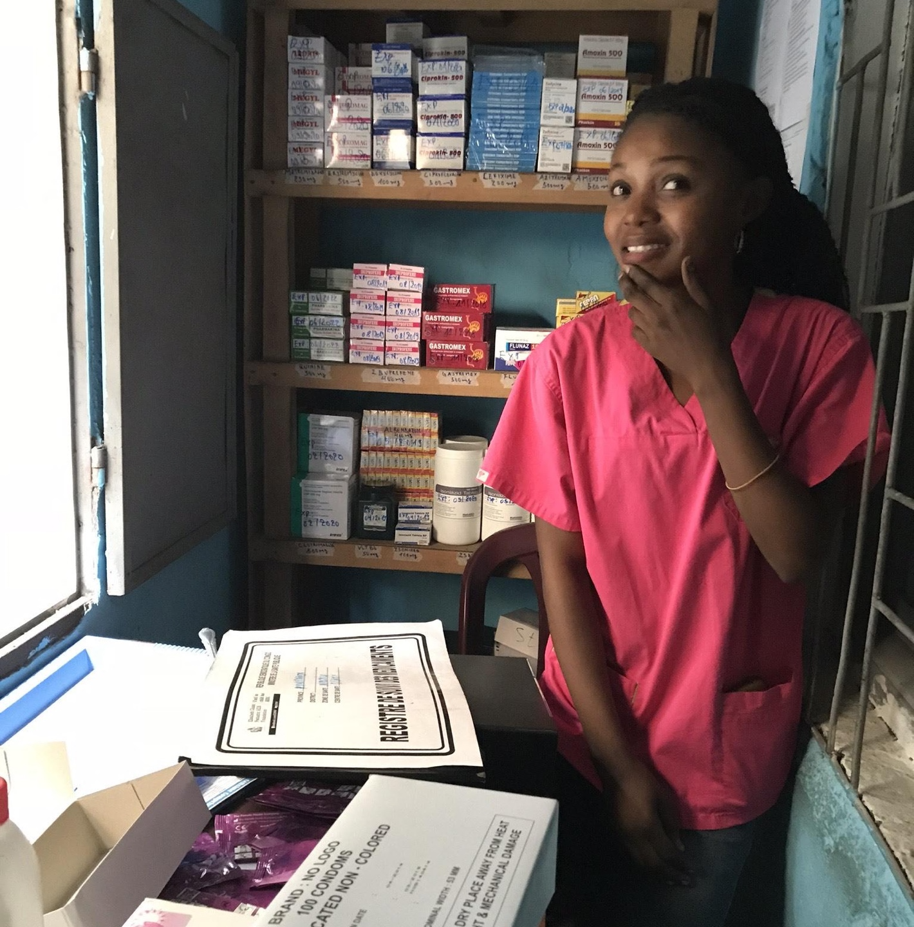
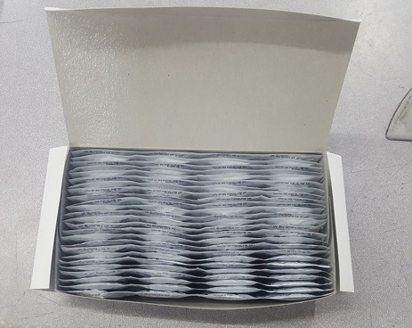
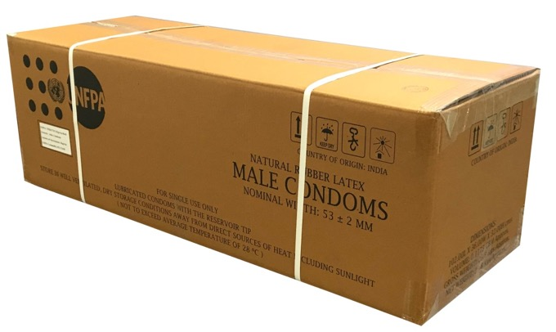
Why does contraceptive packaging matter?
Notes:
Scenario: You are a nurse at a small health facility that provides contraceptives to clients. You are responsible for stockkeeping in your facility to ensure a consistent supply of quality contraceptive products. To do this, you keep a record of quantities you dispense to clients (you can see her record book there), you organize the storage of your stock (you can see the labels on her shelf) and you place orders with a warehouse or larger facility for re-supply. For this job, in addition to all your other skills and training, you need to be comfortable with math. Last month, you dispensed 60 male condoms to clients at your facility, leaving you with only a partial box. (Take a look at her box of 100 condoms out front ready for dispensing). You know you need to order more condoms to avoid stocking out, but how many do you order? Let’s say you decide to order one box of condoms. That’s not so hard – you order one box of 100 condoms and next month you with have 160 total condoms (minus whatever you dispense in the meantime) which means you don’t stock out.
BUT what if on your order form you listed “1 box” expecting to receive one box of 100 pieces of male condoms. Then on delivery day you received “one box” – an export carton of 7200 pieces of male condoms?!
You now have more condoms than your facility anticipates distributing in 20 years! The condoms will expire by then, and meanwhile you have no place to store this large box in your tiny facility store room, so what do you do? You can ask the warehouse to take it back (reverse logistics), take it upon yourself to distribute these condoms among other facilities nearby, or try to destroy them. All options are wasteful and costly, and you already are a resource limited, busy health facility.

Slide 7
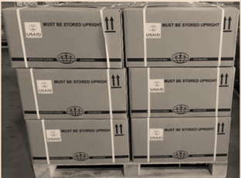
Packaging is important at every supply chain level
Global supply chain
In-country supply chains
Manufacturing, global procurement, international delivery and warehousing
In-country storage and distribution, picking/packing at warehouses
Management at service delivery points
Export cartons on pallets
Inner boxes or saleable units
Dispensing unit
Notes:
That’s one example of product packaging issues that happen at the service delivery point level. But packaging has an impact on every level of the supply chain.

Slide 8
Background Goals
Updating the packaging presentation for contraceptive products can:
Improve coordination among the global community
Reduce the cost of contraceptive products
Improve commodity security through increased flexibility
Decrease environmental impact and waste
Notes:
Because we acknowledge the importance of packaging, USAID, UNFPA, and GHSC-PSM began a multi-year, coordinated effort to consider improvements how products are packaged. The goals of the overall activity are four-fold: improve coordination among donors and suppliers, decrease costs that may come from savings or reduced waste, realize supply chain efficiency improvements at the global and local level, and decrease the environmental footprint of contraceptive commodities.
Should we mention as well the benefits for our suppliers? UNFPA and USAID by shipping the same SKU support the brand of the suppliers as a good quality product to be used by consumers. For example, with the Blue Lady we have developed a brand which is recognized in all the public sector as a good quality product at an affordable cost.

Slide 9
Methodology A team effort between USAID, UNFPA, GHSC-PSM
Green Packaging Innovations
Desk Study
Case Studies
Conducted desk study to document where UNFPA and USAID packaging specifications align and diverge and to identify rationale for current packaging specifications across key contraceptive products. Conducted interview with key suppliers to understand manufacturing capabilities and constraints.
Conducted case studies in Mozambique, Rwanda, Zambia, and Zimbabwe to understand impact of packaging configurations on in-country supply chains across key contraceptive products.
Explored opportunities for innovations in greener packaging and reduction of environmental impact with focus on MPA-IM.
Notes:
We started simply with the question of “what is the rationale for all the various packaging specifications for our contraceptive products”? Why are there so many differences among otherwise interchangeable products?
First, examined the current state of packaging rationalization and divergences in a desk exercise.
Anecdotal observations in-country led us to explore more specific case studies in four counties to understand how variable packaging impacts local supply chains.
Looking at the global level, and with and eye to donor coordination, we then conducted interviews with manufacturers who supply contraceptives to both USAID and UNFPA. We also asked them about best practices in packaging and if they had feedback for procurers on options that would involve cost savings or other benefits.
We found that actually many suppliers are also leading the way in reducing the environmental impact of packaging waste, so offer a variety of options to clients.
In 2021, we worked with a green packaging specialist to identify recommendations.
In 2022, we began implementing recommendations that resulted in this work and planning for future packaging changes.

Slide 10
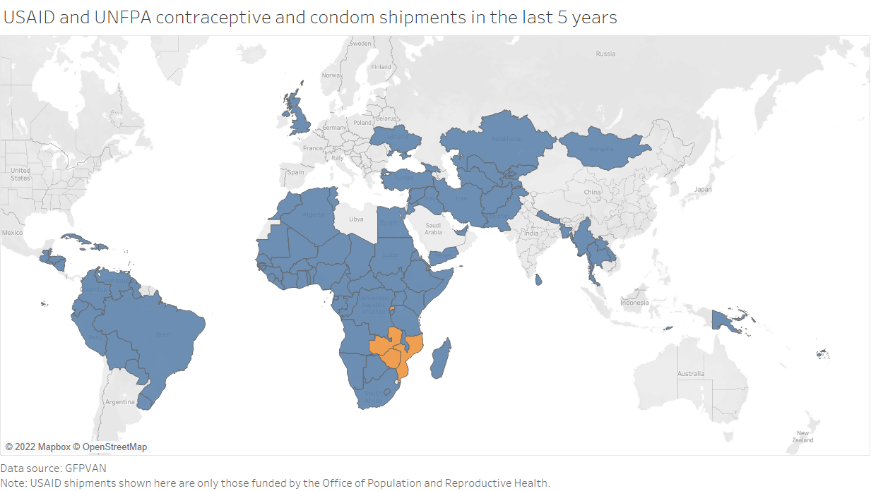
Methodology Country selection driven by country procurement volumes and product variety
Mozambique, Rwanda, Zambia, and Zimbabwe were visited in 2018 for country case studies
Notes:
We chose countries for case studies based on their profiles of receiving multiple contraceptive products from both USAID and UNFPA, and based on volumes ordered.
We performed qualitative structured interviews with warehouse, service delivery point, and social marketing organization stakeholders. Unstructured interviews were conducted with government and other stakeholders. We visited every major supply chain level in each country.
Participants were from high volume sites, low volumes sites, rural sites and urban sites.
Verbal informed consent was obtained from all participants in Mozambique, Zambia and Zimbabwe before initiating in-depth interviews .
Ethical approval was received in Rwanda from the Rwanda National Ethics Committee and the National Health Ethics Committee. Written informed consent was obtained from all participants in Rwanda before initiating in-depth interviews.
Interview data was analyzed thematically in Microsoft Excel by categorizing responses according to a framework based on themes from the interview guide.
Sample size:
19 warehouses were sampled across 4 countries, including 8 central warehouses, 5 provincial/regional warehouses and 6 district warehouses.
18 service delivery points (SDPs) were sampled across 4 countries, including: 4 hospitals, 7 urban/peri-urban health centers, 6 rural health centers and 1 nongovernmental organization (NGO).
7 social marketing organizations (SMOs) were sampled across 4 countries, including: SFH/PSI, DKT, DISCOVER Health and PSZ.
Other stakeholders sampled included ministries of health, national AIDS councils, UNFPA, USAID-funded projects, and civil society organizations.

Slide 11
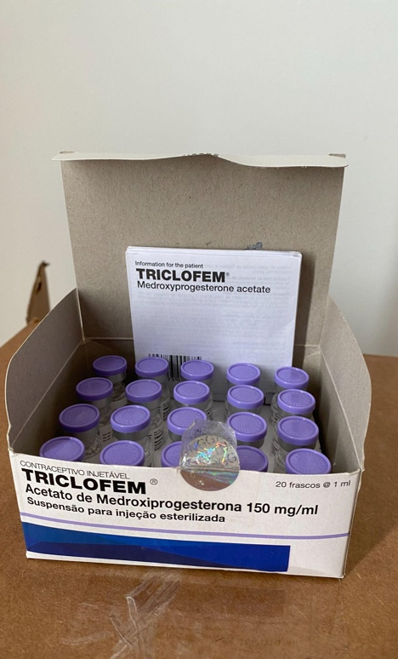
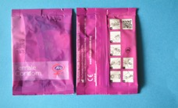
Methodology Product selection
Male Condoms
Female Condoms
Medroxyprogesterone Acetate Intramuscular Injection (MPA-IM)
Personal Lubricants
Combined Oral Contraceptive Pills
Contraceptive Implants
Intrauterine Devices (Copper T)
Notes:
Our study looked at seven products procured by both donors, the largest volume products with overlap. For this presentation, I will focus on findings for three products: male condoms, female condoms, and injectable contraceptives (MPA-IM).

Slide 12
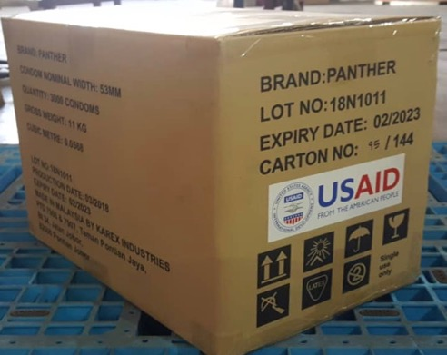
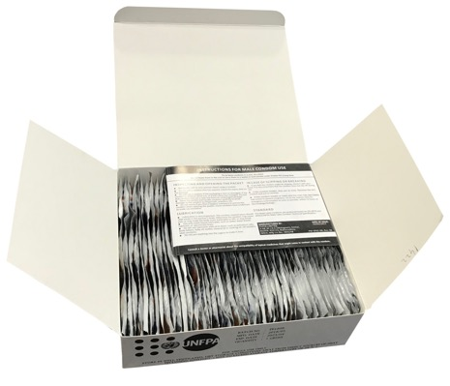
Male Condoms Packaging differences between USAID and UNFPA
Notes:
USAID
Export Cartons of 3,000 pieces/30 inner boxes per export carton/100 pieces per inner box
**# of export cartons per pallet varies by supplier (15-16)**
UNFPA
Export Cartons of 7,200 pieces/Inner boxes of 144
** # of export cartons per pallet and Inner boxes per export carton varies by supplier**
USAID was unaware of the rationale for strips of 4. GHSC-QA indicated that USAID determined inner boxes of 100 pieces is more manageable for programs from a warehousing and distribution perspective.
UNFPA indicated rationale for packaging in strips of 3 is because men use an average of 3 condoms per week. However, freight cost is higher for packaging in export cartons of 7,200 pieces.

Slide 13
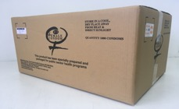
Female Condoms Packaging in large quantities
(Zimbabwe only)
Dispensing Unit
Export Carton
Notes:
FC2/Veru
UNFPA/USAID—Pallets of 15 export cartons/Export cartons of 3,000 pieces
USAID---Pallets of 180 export cartons/Export cartons of 3 inner boxes/inner boxes of 20 sachets

Slide 14
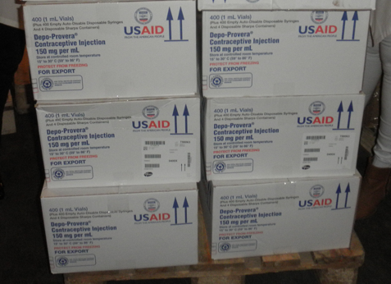
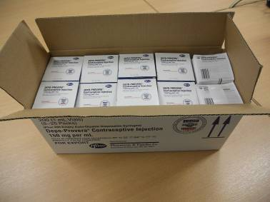
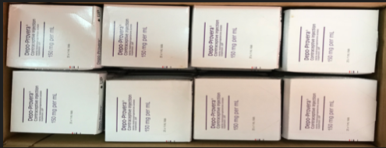
MPA-IM Packaging differences between USAID and UNFPA; not bundled
2 intermediary boxes per export carton
12x200 syringes per intermediary box
40x25 vials per intermediary box
4 safety boxes per export carton
Notes:
UNFPA packaged 40 packs of 25 vials per export carton; 12 inner boxes of 200 syringes per export carton

Slide 15
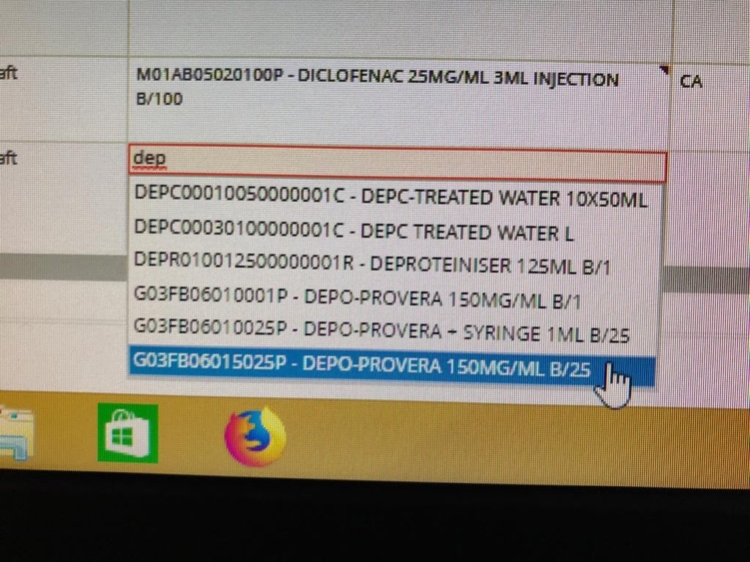
Results Case studies
Key challenges identified by in-country stakeholders
Saleable unit sizes inconsistent with facility-level ordering
Labeling inconsistencies among box levels leads to confusion
Miscommunication of stock availability due to multiple SKUs for one product
Injectables (Depo-Provera): Rwanda eLMIS
Notes:
Labeling:
Stakeholders experienced challenges receiving the wrong product as a result of no labelling or mislabeling of packaging.
“It would be helpful if each box was labelled with what products are included in each box. We have received boxes intended for other facilities in the past.” - Zambia
Include labelling on each level of packaging that indicates product information such as:
Name of product
Batch number
Expiration date
Quantity
Global trade item number (GTIN)
Include labelling or packaging clearly identifying free public sector products from socially marketed products.
MPA-IM
Stakeholders expressed challenges receiving syringes and vials in equal quantities. Stakeholders indicated when syringes are not available, the service provider will typically use whatever syringe is available to administer DMPA-IM.
Stakeholders expressed challenges related to shortage/stockout of burn boxes. Burn boxes are not received regularly and when received are used for all syringes at SDP.
Insert packs were not observed at the SDP level.
Stakeholders expressed a preference for the bundled product with a greater preference for 1 vial and 1 syringe to be packaged together in a single dispensing unit.
“Sometimes [we] distribute Depot without syringes. When this happens, the health facility calls, and we transfer later. It would be better to have the Depot and syringe in the same box [dispensing unit]. It is better for the provider to take one kit to the client without any confusion.” – Rwanda
DMPA-IM Burn boxes
Country case studies revealed that burn boxes were not received regularly at the SDP, and there were often stockouts/shortages at the SDP
Country case studies revealed that burn boxes may not be making their way from the warehouse to the SDP, leading to shortages/stockouts at the SDP

Slide 16
Results Male condoms challenges and preferences
Stakeholders experienced confusion with multiple packaging configurations.
Stakeholders expressed a preference for inner boxes of 100 pieces
“Sometimes there is confusion when picking and packing. Staff can take a pack [inner box] of 144 pieces thinking it is a pack [inner box] of 100 pieces.” – Rwanda
“The challenge is in terms of stock management: Pharmacists may be required to maintain two stock cards to manage various sizes [of packaging].” – Rwanda
Ensure consistency in packaging among major procurers.
Preference for inner boxes of 100 pieces because they are easier to count.
Consider option of pillow packs of 10 pieces each
“[Inner boxes of] 100 is better because it is easier to count. Health centers order by individual pieces and it is easier to adjust orders to [inner] boxes of 100 [pieces].” - Rwanda

Slide 17
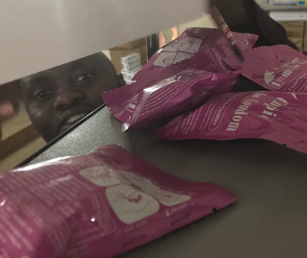
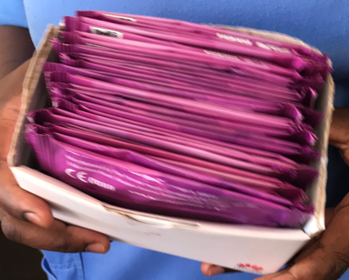
Results Female condoms challenges and preferences
Stakeholders experienced challenges with the large quantity of sachets contained in the export carton.
Stakeholders expressed a preference for quantities of 100 sachets or less per export carton or inner box.
Stockouts of female condoms were observed in service delivery points.
Notes:
Pieces of email condoms loosely stored on a warehouse shelf, with the stock card next to it. These can easily be lost or damaged
Here a facility has created their own improved inner packaging of smaller quantities of female condom pieces

Slide 18
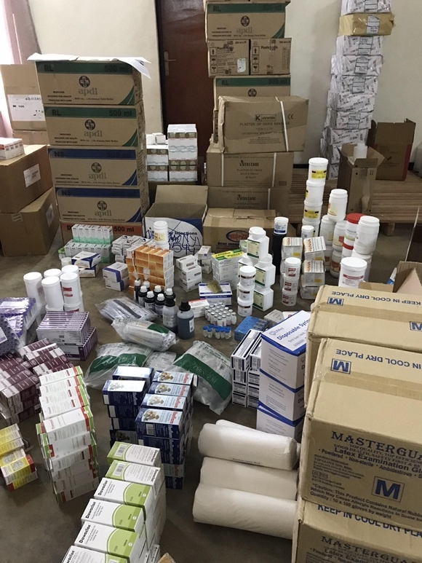
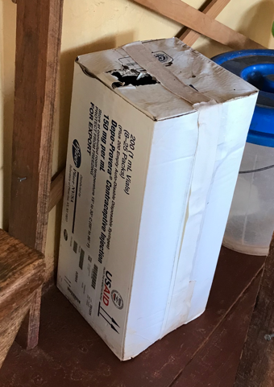
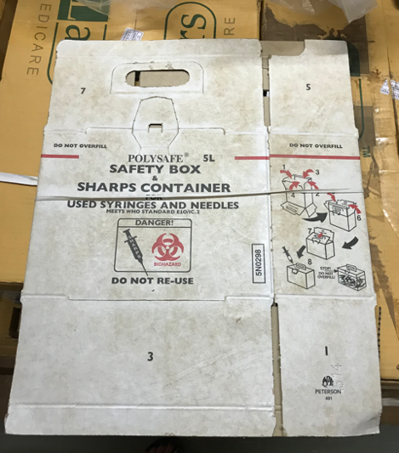
Results MPA-IM challenges
Picking/packing vials and syringes
in equal quantities
Safety boxes separated at warehouse; unavailable at facilities
Notes:
Stakeholders expressed challenges receiving syringes and vials in equal quantitates. Stakeholders indicated when syringes are not available, the service provider will typically use whatever syringe is available to administer MPA-IM.
Stakeholders expressed challenges related to shortage/stock out of burn boxes. Safety boxes are not received regularly and when received are used for all syringes at SDP.
Insert packs were not observed at the SDP level.
Safety boxes did not make it to the facilities.

Slide 19
Results MPA-IM preferences
Stakeholders expressed a preference for the co-packaged product consisting of a smaller number of vials and syringes of equal quantity packaged together.
“Sometimes [we] distribute Depot without syringes. When this happens, the health facility calls and we transfer later. It would be better to have the Depot and syringe in the same box [dispensing unit]. It is better for the provider to take one kit to the client without any confusion.” – Rwanda
“It is better to go with one packaging configuration where syringes are co-packaged. It is very resource intensive to look at each individual order to ensure syringes were ordered. Safety boxes are also appreciated at the facilities.” – Zambia
“It is a problem when vials and syringes are unbundled because they must be kept separately in the system. It is better to package syringes and vials together in the same inner box.” – Zimbabwe

Slide 20
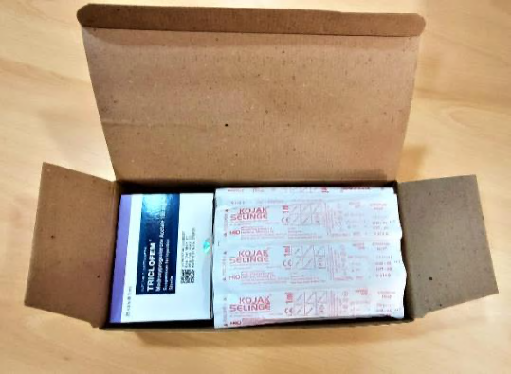
Recommendations
Male condoms: USAID and UNFPA catalogs offer the same export carton of 3,000 pieces and inner boxes of 100 pieces Implemented in 2020
Female condoms: USAID and UNFPA offer export cartons with quantities <1,000 pieces Implemented in 2020
MPA-IM: Remove the safety box; order separately Safety boxes available separately in USAID catalog
MPA-IM: package in co-packaged presentation, with a preference for packaging the vial and syringe in the same dispensing unit New smaller bundle to be introduced in 2023
Notes:
HIGHLIGHTS OF THE PRESENTATION
The importance of close collaboration in the area of packing alignment allows price stability in a changing environment of price increases
The fact that both procurers ship the same type of presentation, brands and products allows interchangeability of products between programs and final users avoiding overstocks, stockouts and closer collaboration in areas like product transfer in case of emergencies, when needed, among procurers.

Slide 21
The Path to Greener Donor Procurements through Contraceptive Packaging Improvements
Morgan Simon, GHSC-PSM
Notes:
Good Afternoon, My name is Morgan Simon. I work with the Global Health Supply Chain-Procurement and Supply Management project or GHSC-PSM.
Today, I am pleased to be sharing our work on ”The Path to Greener Donor Procurements through Contraceptive Packaging Improvements.”
Building on the desk study and country case studies presented by Ashley, we wanted to not only optimize packaging to respond to the needs of in-country supply chains but to also optimize packaging for sustainability.

Slide 22
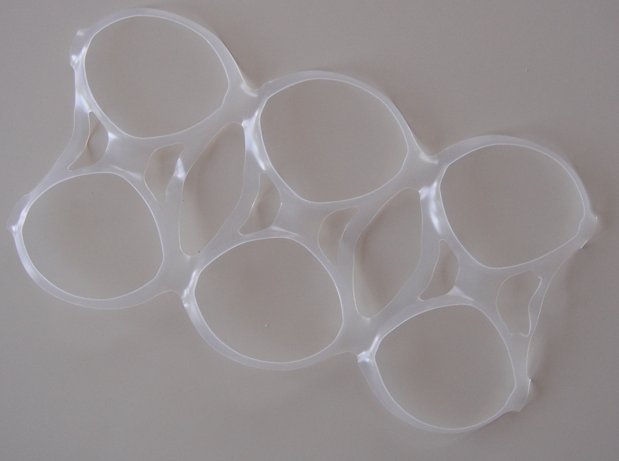
What is green packaging?
Notes:
So, what is green packaging?
In recent years, many consumer goods companies have made commitments to sustainable packaging. We have all experienced this in our daily lives. For example, the six pack of beer I purchase at my local corner store is now packaged with paper can toppers in lieu of plastic neck rings.
Plastic is difficult to recycle and poses a major threat to wildlife, marine life and the environment. In fact there is an estimated 270,000 tons of plastic floating in our oceans that threatens 700 marine species with its presence.

Slide 23
What is green packaging?
Packaging plays a critical role in almost EVERY industry, EVERY sector and EVERY supply chain.
In the pharmaceutical industry, packaging is essential to maintain the quality of the product. Packaging protects the product not only from physical damage but also from biological degradation.
Green packaging initiatives may include:
REduce Reduce the volume of packaging materials
REuse Reuse of secondary and tertiary packaging materials
REcycle Use of recycled materials
Notes:
Packaging plays a critical role in almost EVERY industry, EVERY sector and EVERY supply chain
In the pharmaceutical industry…
Green packaging initiatives often leverage the 3 Rs of sustainability: Reduce, Reuse, Recycle
One of the easiest ways to improve the sustainability of packaging and distribution is to reduce the amount of material used
Another strategy for reducing packaging waste is to select materials that can be easily reused. Reusing materials keeps them out of landfills and reduces the volume of materials that must be produced.
Finally, use of recycled materials reduces resource consumption and the impact on the environment.

Slide 24
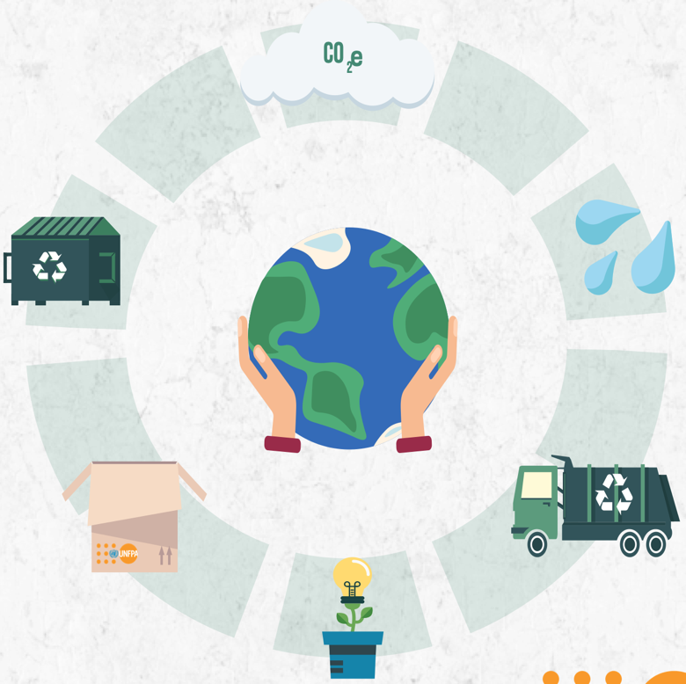
How can we measure green packaging?
Green packaging can be measured against the following metrics:
Carbon footprint (CO2) emissions
Solid waste generation
FSC certified cardboard boxes or equivalent use
Water use and pollution
Recycled post-consumer materials use
Electricity use
Notes:
It is important for us to measure progress on the path to greener donor procurements.
So, how can we measure green packaging?
Green packaging can be measured against the following metrics:

Slide 25
Methodology
Investigate best practices in green packaging across key contraceptive product categories procured by USAID and UNFPA and develope recommended changes to secondary and/or tertiary packaging
Ensure recommendations would not negatively impact product quality​.
Assess the environmental impact of various MPA-IM packaging options, including impact feasibility assessment and/or cost benefit analysis for each recommendation​.
Notes:
Now that we share a common understanding of what green packaging is, what is it that we aimed to achieve?
We set out to investigate best practices in green packaging across key contraceptive product categories procured by USAID and UNFPA and develop recommended changes to secondary and tertiary packaging.
Importantly, we focused on secondary and tertiary packaging to ensure recommendations would not negatively impact product quality.
For implementation of specific recommendations, we choose to focus first on Medroxyprogesterone Acetate Intramuscular Injection (MPA-IM) as this is a high volume product category for USAID and UNFPA.

Slide 26
We identified 5 key packaging improvements to achieve supply chain efficiencies on the path to greener procurement
5 key packaging improvements
Remove plastic straps from export carton
Remove plastic liners and Styrofoam from export carton
Remove logos from export carton
Separate safety box from MPA-IM co-package
Develop and introduce 20-vial MPA-IM bundle
Notes:
Through our assessment, we identified recommendations for improvements to the packaging of donor-procured contraceptive commodities. Select examples of priority recommendations for packaging improvement and associated impact are listed here on the slide.
I will discuss the first 4 recommendations in detail on subsequent slides and Jens will deep dive into the final recommendation with his presentation.
Importantly, implementation of these priority recommendations can result in upstream supply chain efficiencies (such as reduced lead time, increased fungibility of product, and ability to leverage economies of scale) and downstream supply chain efficiencies (such as enhanced commodity supply security, improved in-country distribution, and stock taking).
Additionally, implementation of these recommendations can reduce the environmental impact of donor procurements and generate potential cost savings.

Slide 27
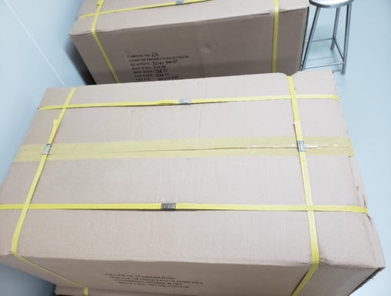
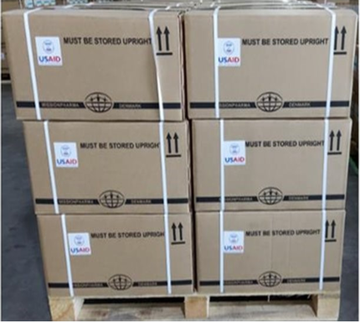
Removal of plastic straps from export cartons
Environmental Savings
Cost Savings
Elimination of 11,008 kg of plastic
Elimination of 156,307 kg of CO2 emission
Elimination of 385,264 KwH
Estimated total annual savings of $17,766
Additional Benefits
Minimize damage to export cartons.
*Estimated Savings based on FY22 USAID and UNFPA procurement volumes.
Notes:
Plastic straps (identified by the red dots on the images here on the slide) are made of difficult-to-recycle materials including polypropylene, polyester, and steel.
Removal of plastic straps from export cartons can reduce environmental impact, minimize damage to export cartons, and generate potential cost savings.
In fiscal year 2022 USAID and UNFPA procured a combined 62 M vials of MPA-IM. Removal of plastic straps from MPA-IM export cartons could therefore generate a potential cost savings of up to ~$18,000 USD, reduction of plastic usage by up to 11k kg, reduction in CO₂ emissions of up to 156k kg, and reduction of energy usage of up to 385k kilowatts annually.

Slide 28
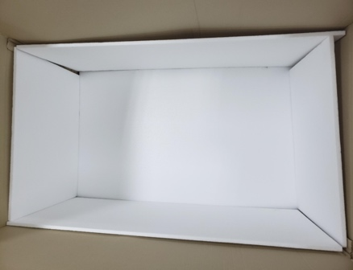
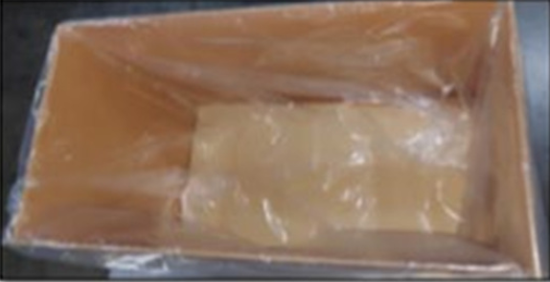
Removal of plastic liners and Styrofoam from export carton
Environmental Savings
Cost Savings
Elimination of 872 kg of plastic
Elimination of 12,389 kg of CO2 emission
Elimination of 30,535 KwH
Estimated total annual savings of $3,847
Additional Benefits
Less than 1% incident rate due to water damage.
*Estimated Savings based on FY22 USAID and UNFPA procurement volumes.
Notes:
In addition to plastic, styrofoam is one of the worst packaging products for the environment and takes 500 years to degrade in landfills.
Based on USAID and UNFPA combined fiscal year 2022 procurement volumes, removal of plastic liners and Styrofoam from MPA-IM export cartons could generate a potential cost saving of ~$4k USD, reduction of plastic usage by up to 872 kg, reduction of CO2 emissions up to ~12k kg and and reduction of energy usage up to ~31,000 Kilowatts annually.
Suppliers indicated plastic liners and Styrofoam edge supporters provide protection against liquid damage and moisture. However, donors have experienced less than a 1% incident rate due to water damage, supporting implementation feasibility.

Slide 29
Removal of logos from export cartons
Environmental Savings
Cost Savings
Elimination of 47g of vinyl
Minimizes release of ink, glue and sticker residue into the environment
Estimated total annual savings of $940
Additional Benefits
Enhanced fungibility of product to more effectively respond to emergency requests
*Estimated Savings based on FY22 USAID and UNFPA procurement volumes.
Notes:
Vinyl sticker logos often adhered to the export carton are toxic to produce and consume. When a vinyl sticker breaks down, it leaves behind tiny pieces of microplastic pollutants. Vinyl stickers are not easily recyclable as the adhesive interferes with recycling equipment. Additionally printed logos release ink into the environment.
Based on USAID and UNFPA combined fiscal year 2022 procurement volumes, removal of such logos from MPA-IM export cartons could generate a potential cost saving of ~$1k USD and reduction of plastic usage by up to 47 kg annually while also minimizing the release of ink, adhesive and sticker residue into the environment, and, perhaps most importantly, enhance the fungibility of product to create greater efficiencies for suppliers.

Slide 30
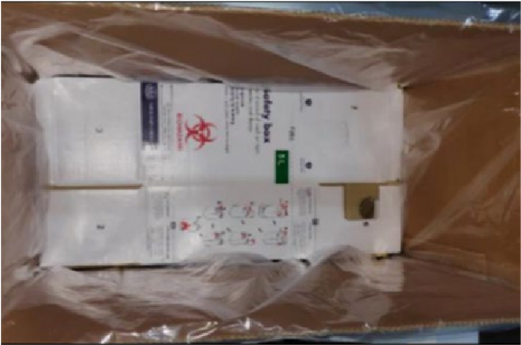
Separate safety box from MPA-IM co-package
Additional Benefits
Facilitates in-country distribution of safety box separately
Facilitates opportunity for local procurement of safety box
Harmonization of SKUs between USAID and UNFPA
Notes:
Ashley discussed some of the challenges associated with the safety box during her presentation.
This final recommendation to unbundle the safety box from the MPA-IM co-package directly responds to the needs of in-country supply chains by facilitating movement of the safety box from the central warehouse to the service delivery point. This recommendation also facilitates local procurement of the safety box for countries who prefer to source locally and harmonization of SKUs between donors.
HIGHLIGHTS OF THE PRESENTATION
Packaging plays a critical role in protecting the quality of the product. Recommendations to improve packaging focus on secondary and tertiary levels of packaging and were not considered if they compromised product quality.
Many industries are moving to improve the sustainability of their packaging
Morgan has explained the benefits of green packaging, how you can measure green procurement via CO2 emissions, solid waste generation, consumption of water, use of electricity.
In specific Morgan has explained what we can do in the case of MPA IM to make the product more adapted to program needs but as well more sustainable referring to the removal of the liners, reducing the level of plastics, etc.

Slide 31
Supplier Efficiencies Generated by Packaging Harmonization of Medroxyprogesterone Acetate (MPA-IM) Injectable Contraceptive
Jens Rasmussen, Missionpharma

Slide 32
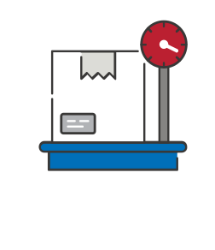
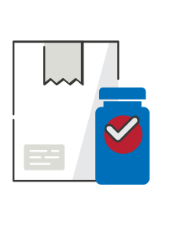
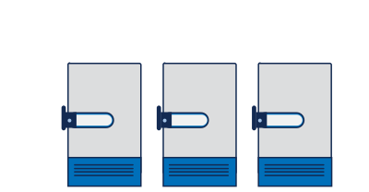
About Missionpharma
In numbers
110
Million USD in revenue
5
locations
1975
Commencing business
2012
part of Toyota Tsusho Corporation, CFAO group and Eurapharma
Notes:
This presentation is not about Missionpharma but about the work we are doing to minimize our carbon footprint and live up to our own goals of minimising the impact of our business operation and the SDG 13 goal.. This is why we with pleasure entered into a dialogue on the subject with GHSC-PSM, UNFPA and USAID. A great example of a private public partnership.

Slide 33
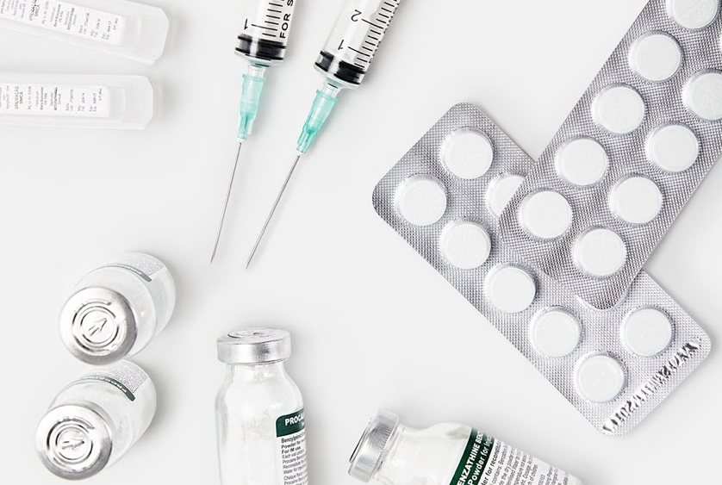
About Missionpharma
About
Missionpharma is a global supplier of generic pharmaceuticals, medical devices, hospital equipment and health kits to public and private institutions, international development organisations and UN entities.
Missionpharma has worked with MPA for 10 years.
Notes:
You have heard MPA-IM and DMPA it is the same product.

Slide 34
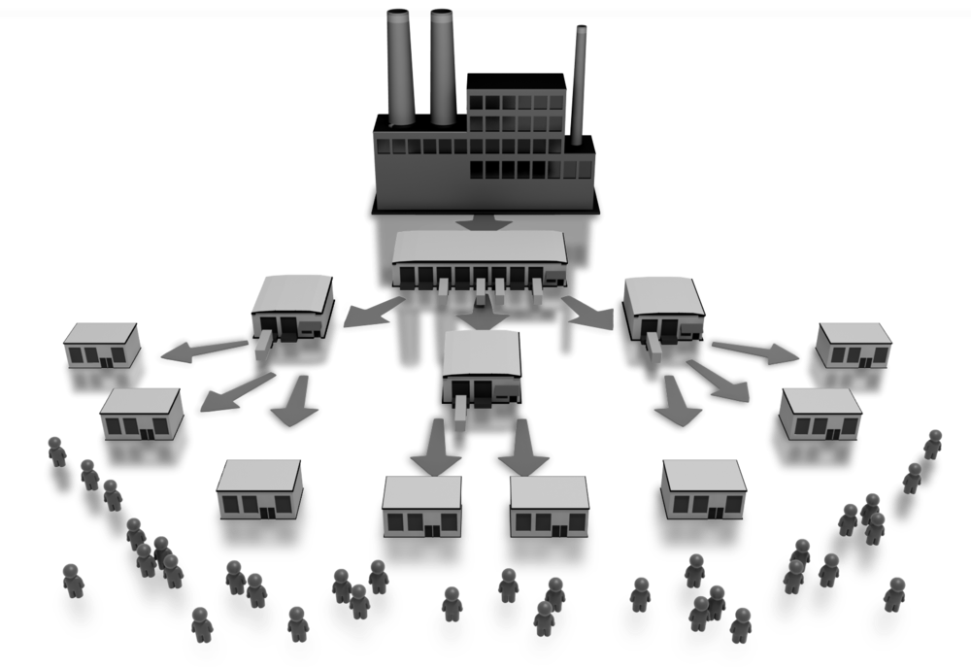
What can we do?
Manufacturer
Warehousing
Health facilities
Patients
Notes:
When you look at the supply chain you have to consider all aspects from A-Z and evaluate where you can make an impact. The purpose of this presentation is to describe the work we have initiated together with UNFPA and GHSC-PSM to harmonize and minimize the environmental impact we make when supplying MPA-IM. We have been analyzing where we can make an impact not only for the environment but for the end users When focusing on minimizing the carbon footprint you may find that one single initiative seems like a drop in the sea. This is actually what it is all about. Creating and thinking a lot of small initiatives. Our products are supplied in huge quantities to central warehouses in the receiving countries and downstream from there. Distribution is then taking place to regional warehouses, hospitals, but certainly also to individual clinics. Clinics which have difficulties administering boxes of 500 vials at the time resulting in wastage and expired products. What about syringes where are they coming from etc. A lot of logistical challenges.

Slide 35
What has been done?
Results
A survey among USAID/UNFPA beneficiaries was conducted in 2021/2022
Preferences were weighed against optimization and environmental considerations
We started working on optimal solutions
Harmonizing packaging between USAID and UNFPA
Reducing wastage and at the same time meeting end-user preferences
Notes:
A clear dilemma. USAID UNFPA conducted a survey in 2021 among end users and various stakeholders. On one hand the single vial pack is preferred on the other hand a 500 vial / syringe pack is the most optimal. Financially as well as environmentally. By harmonizing the packaging USAID/UNFPA has been able to “share” capacity in among others Burundi avoiding stock outs.

Slide 36
2-fold challenge
Bulk
Single Vial Presentation
500 vials and 500 syringes in a box
1 vial and 1 syringe in a unit carton
Notes:
So we have tried to attack the twofold challenge. On one side we can benefit from the bulky supply which has a reduced consumption of packing material or the single vial with everything included to administer the MPA. Let me illustrate the difference.

Slide 37
Volume comparison
Bulk
Single Vial Presentation
23,040 vials per pallet
9.000 vials if co-packaged with syringes
4,000 vials per pallet
Notes:
Considering on one hand shipping 23.040 vials on one pallet vs 4.000 single kits is a tremendous difference. It is 576 % difference. From one ”extreme” to another. This made us aware that there was a case to work on here.
The single vial is actually the most preferred presentation.

Slide 38
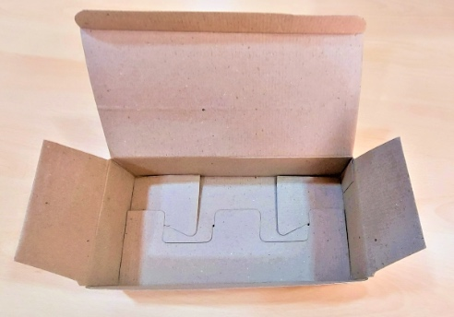
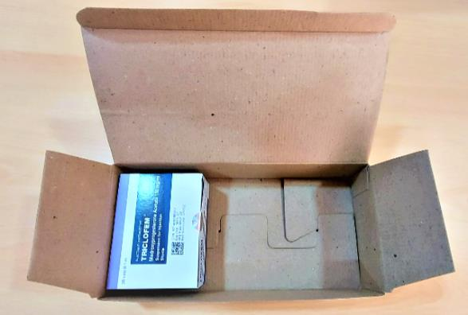
20 vial bundle
Notes:
So we started to develop a kit considering the environmental impact in terms of logistics as well as enduser preference. We know from interviews that the export cartons are broken down along the supply chain to accommodate specific needs. The end result is a 20 vial kit with vials and syringes bypacked. This will reduce packaging material compare to the single vial kit and a the same time accommodate end user requirements. In a 20 vial kit you have DMPA for 5 women for one year. Products have 5 year shelf life

Slide 39
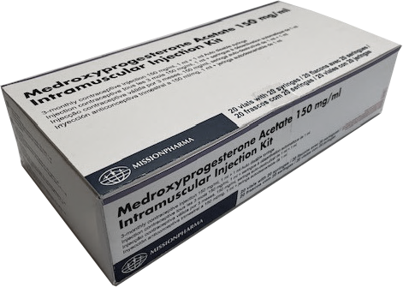
20 vial bundle
20 vials of MPA-IM
20 syringes, 1 ml
1 leaflet (instructions of use)

Slide 40
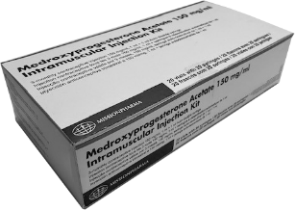
Bundle reach
3-monthly injection
x 4 per year
20 vials of MPA-IM
20 syringes, 1 ml
1 leaflet (instructions of use)
1 bundle of 20 vials
protects 5 women per year
Notes:
In a 20 vial kit you have MPA for 5 women for one year. This should meet the requirements of the smallest possible clinic.

Slide 41
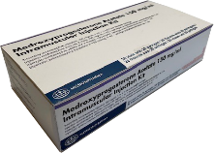
Volume comparison
Bulk
Single Vial Presentation
20 Vial Bundle
23,040 vials per pallet
4,000 vials per pallet
7,200 vials per pallet
Notes:
Considering on one hand shipping 23.040 vials on one pallet vs 4.000 single kits is a tremendous difference. It is 576 % difference. From one ”extreme” to another. This made us aware that there was a case to work on here.

Slide 42
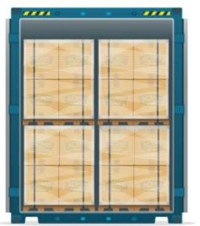
What we do to make MPA deliveries as green as possible
The manufacturer / MP is ISO 14001 certified
50% of total electricity needs in our Indian warehouses is covered by solar power energy
Packaging is optimized to minimize volumes and optimize container loading
USAID / UNFPA consolidate all orders for vials and syringes with significant savings
Possibility to hold stock due to harmonization in packaging requirements from USAID and UNFPA
Customers are encouraged to choose sea shipments instead of air shipments
We minimize use of straps, labels and plastic foil
Notes:
Short explanation of ISO 14001

Slide 43
Conclusion
Harmonization of requirements from USAID and UNFPA towards 20 vial bundle has resulted in:
Reduction of total shipping volume by 40%
Reduction of secondary packaging material by 70%
Meeting end-user preferences / fungibility
Reducing wastage and incineration of expired products
Suppliers to stock MPA and thereby reduce the need for air shipments

Slide 44
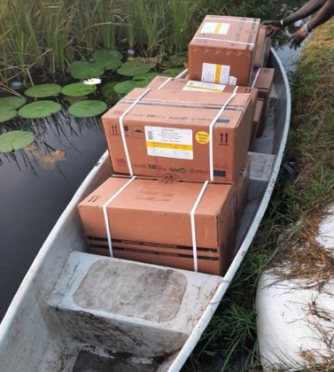
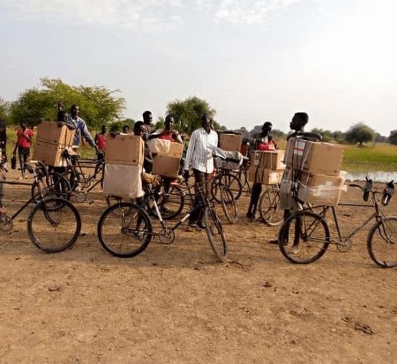
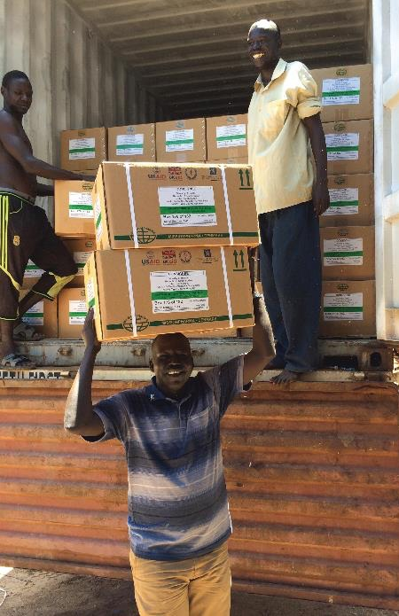
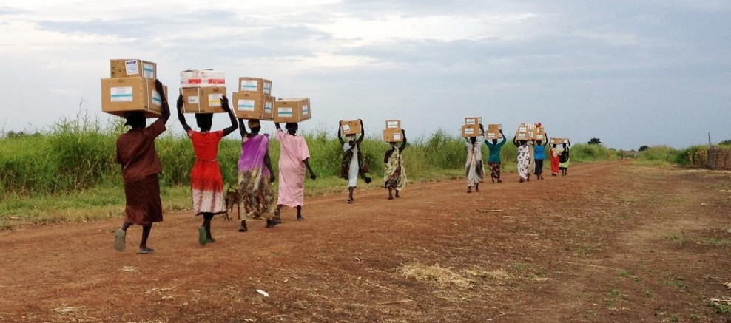
Last mile distribution
In pictures
Notes:
HIGHLIGHTS OF THE PRESENTATION
Seemingly minor changes can have a large impact due to the volumes procured by USAID and UNFPA.
Benefits of smaller MPA-IM: adapting better to the needs of the programs at ground level, alignment of the products supplied by both procurers, reduction of the number of SKUS to be maintained by the suppliers, reduction of waste at local level, easier management of stock in the last mile.
Our products are supplied in huge quantities to central warehouses in the receiving countries and downstream from there. Distribution is then taking place to regional warehouses, hospitals, but certainly also to individual clinics. Clinics which have difficulties administering boxes of 500 vials at the time resulting in wastage and expired products. What about syringes where are they coming from etc. A lot of logistical challenges.

Slide 45
Questions?
Notes:
Questions for Ashley:
***Q: How can the learnings of this close collaboration between UNFPA and USAID/PSM in the area of Contraceptives can be applied in other products/therapies?
Q: In your presentation you mentioned that in 2018 you conducted an exercise with UNFPA and USAID seeking alignment on 7 type of contraceptives, would be an option to consider some joint tender opportunities?
Q: How will new packaging SKUs be differentiated in country? A: New eLMIS SKU; ability to track product etc.
Q: Is the safety box available for local procurement? A: In most countries, yes. Unbundling the safety box creates an opportunity to leverage local procurement for greater efficiencies.
Questions for Morgan:
***Q: Usually more sustainable products come at higher cost too, will donors take into consideration sustainable when doing tenders?
A: UNFPA is already including sustainability of one of the criteria in the scoring of offers. GHSC-PSM is learning from our UNFPA colleagues and anticipates inclusion of sustainability criteria with our next round of tenders for FP/RH products.
Q: In the area of sustainability, it seems important to reduce packaging materials such as the layers of the cardboard, plastic liners, plastic wrappers of inner boxes. Is the plan to start piloting with MPA IM and a group of limited suppliers and countries to ensure the goods arrive in good condition or to go broader in scope?
Questions for Jens:
***Q: Has the 20-vial bundle been ordered by countries?
A: Order will be delivered to Zambia in 2023.
Q: Do you think the bundle presentation USAID/UNFPA is proposing can be of interest of other clients i.e Goverments, other NGOs supplying the same product?

Slide 46
Thank you!
Ashley Smith: amsmith@usaid.gov
Morgan Simon: msimon@ghsc-psm.org
Jens Rasmussen: Jens.Rasmussen@missionpharma.com
Ayman Abdelmohsen: Abdelmohsen@unfpa.org
The USAID Global Health Supply Chain Program-Procurement and Supply Management (GHSC-PSM) project is funded under USAID Contract No. AID-OAA-I-15-0004. GHSC-PSM connects technical solutions and proven commercial processes to promote efficient and cost-effective health supply chains worldwide. Our goal is to ensure uninterrupted supplies of health commodities to save lives and create a healthier future for all. The project purchases and delivers health commodities, offers comprehensive technical assistance to strengthen national supply chain systems, and provides global supply chain leadership. For more information, visit ghsupplychain.org.
The views expressed in this presentation do not necessarily reflect the views of USAID or the U.S. government.

