Slide 1
Contraceptive Security Monitoring through the Coordinated Procurement and Distribution System in Rwanda
Peter ISHIMWE, B. Pharm Commodity Security Advisor, GHSC-PSM
Photo: Lan Andrian

Slide 2
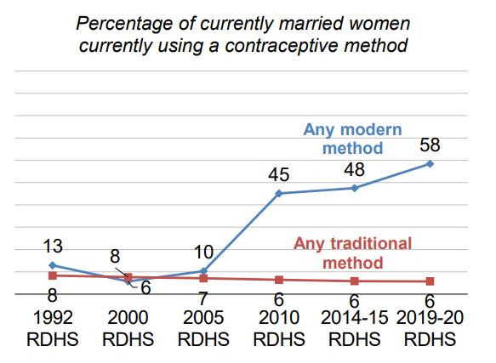
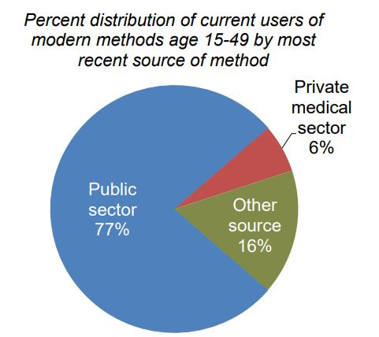
Family Planning in Rwanda
Language: Kinyarwanda, English, French, Swahili
Population: 12.9 million
Women 15 - 49: 63.1%
Life expectancy: 68 for women, 65 for men
Women in Parliament: 61%
Wanted births: The wanted fertility rate is 3.1, while the total fertility rate is 4.1. This suggests that Rwandan women are currently having, on average, one more child than they want.
https://dhsprogram.com/pubs/pdf/FR370/FR370.pdf
Notes:
- Current contraceptive use: Modern contraceptive use is higher among currently married women (58%) than among sexually active unmarried women (48%). The contraceptive prevalence rate for any method is 64% among currently married women.
- Contraceptive discontinuation: About a third of women (30%) who began using a contraceptive method in the 5 years preceding the survey discontinued the method within 12 months. The most common reason for discontinuation was side effects/health concerns (30%).
- Demand for family planning: The total demand for family planning among currently married women is 78%; 75% of total demand is satisfied by modern methods.
- Unmet need for family planning: Unmet need for family planning is higher among sexually active unmarried women (37%) than among currently married women (14%).
- Future use of contraception: 61% of currently married women who are not using contraception intend to use family planning in the future.
- Wanted births: The wanted fertility rate is 3.1, while the total fertility rate is 4.1. This suggests that Rwandan women are currently having, on average, one more child than they want.

Slide 3
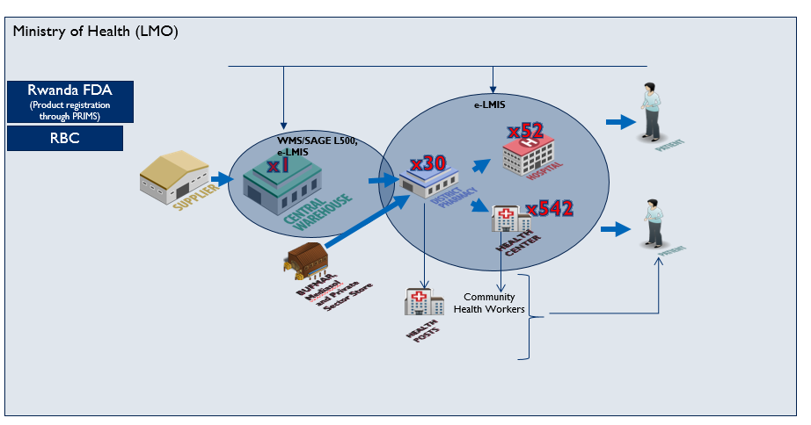
Rwanda Value Chain
In Rwanda, family planning services are provided through eight national referral hospitals (including teaching hospitals), four provincial referral hospitals, 39 district hospitals, 542 health centers, 670 health posts, and 58,567 community health workers (CHWs) operating in 14,873 villages.

Slide 4
WHAT IS CPDS?
Coordinated Procurement and Distribution System (CPDS) is a government mechanism that coordinates and efficiently manages available resources to streamline integration; harmonize program supply chain practices; and improve quantification, procurement, and supply plan monitoring for public health commodities.

Slide 5
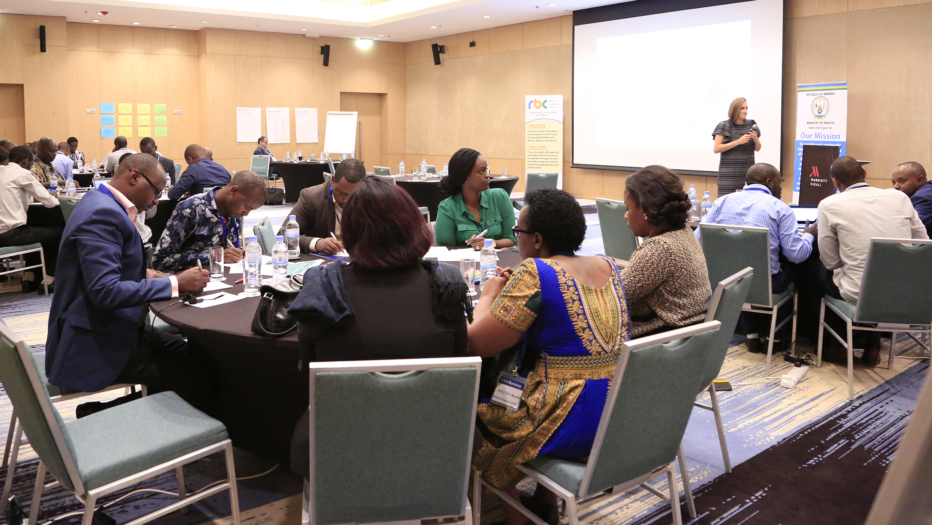
WHY CPDS?
In the past, the procurement of Family Planning (FP) commodities in Rwanda was only coordinated through development partners under the leadership of the Ministry of Health (MoH).
There was no reconciliation of funds available versus gap analysis or data-based assessments and priorities to inform the procurement process.
To address such challenges, the MoH has integrated the forecasting and supply plan activities for contraceptives into the CPDS forum involving all stakeholders in the FP program since 2016.

Slide 6
FP KEY PLAYERS IN RWANDA
USAID
UNFPA
Rwanda Medical Supply (RMS)
Rwanda Biomedical Center (RBC)
Notes:
In Rwanda, the MOH, USAID, and UNFPA are the main funders of FP commodities. In this regard, the funding mechanism is determined every year after a quantification exercise where the MoH and stakeholders, through the CPDS resource management committee, approve the supply plan and mobilize funds to procure contraceptives.
The CPDS monitors the procurement and distribution system progressively to ensure a continuous availability of FP commodities. Throughout monitoring, the CPDS advises the FP program not only on the logistics and procurement aspects of commodities but also provides recommendations on strategies to increase contraceptives uptake in Rwanda.

Slide 7
CPDS Structure
Members | Tasks
1. PS/MOH: Chair 2. RBC 3. MOH/CPHS (Secretariat) 4. RMS 6. USAID 9. UNFPA 10. CHAI 11. USAID/ GHSC-PSM 12. SFH | RMC: Maintains the cohesion of the system with strategies for optimizing the available resources within the restrictions of each individual partner and oversees that the agreed procedures are respected.
Technical Coordination Officer | The Technical Coordination Officer works with partners and stakeholders to strengthen health commodity management for sustained and improved health outcomes by proposing strategies, activities, recommendations, and innovative and responsive solutions.
1. RBC 2. RMS 3. USAID 9. UNFPA 10. CHAI 11. USAID/PSM 12. SFH | QC: Focused on forecasting and supply planning for health commodities. They prepare and carry out annual quantification, quarterly supply plan reviews and monthly stock status review meetings to ensure commodity security. | IC: Focused on ensuring the efficient implementation of supply plans. They provide visibility on the delivery date of planned shipments, changing market trends, and highlighting potential risks and opportunities in the marketplace.
Resource Mobilisation Committee (RMC)
Technical Coordination
Quantification Committee (QC)
Implementation Committee (IC)
Notes:
Resource Mobilisation Committee RMC: The overall purpose of the RMC is to maintain the cohesion of the system by defining the strategies for optimizing the available resources within the restrictions of each individual partner and to oversee that the agreed procedures are respected. The RMC provides the highest level of decision making within the CPDS.
Quantification Committee QC: This is the technical arm of the CPDS focusing on forecasting and supply planning for health commodities. They are tasked to prepare and carry out annual quantification, quarterly supply plan reviews as well as monthly stock status review meetings to ensure commodity security.
Implementation Committee IC: This is the technical arm of the CPDS focusing on ensuring the efficient implementation of Supply plans and provide visibility on the delivery date of planned shipments, changing market trends highlighting potential risks and opportunities in the marketplace.
The technical coordination level of the CPDS is the link between different technical areas (QC and IC) of the CPDS and the decision-making level (RMC). He/She is also the CPDS/MOH focal point for all technical issues related to health commodities managed
within the CPDS.

Slide 8
Results
Over the past five years, CPDS has created a powerful collaborative platform to:
Successfully conduct annual quantifications and supply plan implementation mechanisms of contraceptive products
Increase method mix with the introduction of new contraceptive methods (Sayana Press, hormonal intrauterine device, and emergency contraceptive pills) and market-shaping in collaboration with USAID, UNFPA, and the Clinton Health Access Initiative
Take quick action on the global shortage of contraceptives (shifting from Depo Provera to the alternative injectable contraceptive Triclofem)
Optimize the utilization of available funds, human resources, and time
Harmonize supply chain operation

Slide 9
Lesson Learned
A unique lesson from the CPDS mechanism was to embrace and improve the collaboration between the MoH and stakeholders to advance contraceptive security, cost-effective implementation of strategic plans, and systematic monitoring for greater impact.

Slide 10
THANK YOU !
Peter ISHIMWE, B. Pharm Email: pishimwe@ghsc-psm.org Commodity Security Advisor, GHSC-PSM in Rwanda

