Slide 1



USAID GLOBAL HEALTH SUPPLY CHAIN PROGRAM
Procurement and Supply Management
DH&I: SCIS Maturity Model
GHSC-PSM Pakistan
Muhammad Tariq, Country Director and Ijaz Haider Malik, Director MIS/IT
25 November 2020

Slide 2

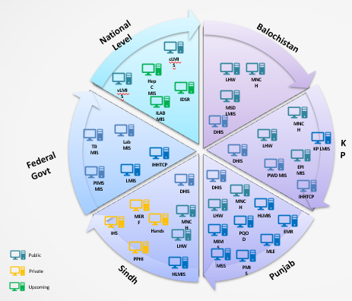














Like many countries, Pakistan is managing IT dispersion…..
Fragmented systems
Introducing first time in the Health eco system of Pakistan
Fragmented systems
Interoperability
Non-standard systems with heterogenous data
Technology
Data
Delayed reporting frequencies - mostly monthly
Open-Source Enterprise Service Bus (ESB)
Master Data Management
(MDM)
Data quality and reliability issues – missing data intelligence
P2P Interfacing & heterogenous systems
Private Sector’s data visibility is near to zero, no PSE policy & standards
MDM
Systems hosted at private data centers
Enterprise Service Bus
Queue#1
Queue#2
Queue# n
Limited ICT and HR Resources at HFs
18th Amendment - devolution
Notes:
What it means for Public Health?
Interoperability

Slide 3






We have a targeted course of action: Pakistan LMIS & SCISMM
Draft Version
Background
Pak LMIS started in 2012 with FP and EPI Program
1
SCISMM
Implemented across Pakistan for Family Planning, Vaccines, Medicines, COVID-19 supplies
Identified gaps,
Prioritized &
Implemented
Provided feedback
5
Process
2
Modular approach
Granular information related to module functionalities
Demand Planning, Inventory, Warehouse Management, Supply Planning, Forecasting, Quantification, Rich analytics and dashboards, Alerts and notifications
4
3
Roadmap to achieve maturity
Assessment
Feedback incorporated
1st Assessment on SCISMM in
Mar 2019
3

Slide 4
Human resources slide 3
SCISMM – Pakistan context
Leverage from Assessment |  | Improvements
Methodologically identified the gaps between the implemented system(s) and a mature Supply Chain system SCISMM provides granular details on the standard functionalities to be implemented for maturity Excellent tool to continuously assess and improve the maturity level of the system |  | New modules and functionalities introduced in the system mentioned in SCISMM like Purchase Order and funds management Forecasting and Quantification
Benefits |  | Suggestions
It provided opportunity to assess the system as per international best practices. Identified areas where further improvements are required Road map to make system fully mature |  | Tool digitization (centralized database) End user to view the improvement in maturity from day one to till to date. Benchmark comparison Training material & video Expand the community by making it available over the internet (open access) Regular releases with improvements in the assessment, based on SCISMII community feedback.

Slide 5
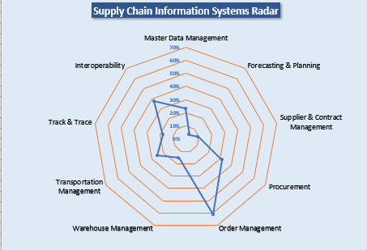
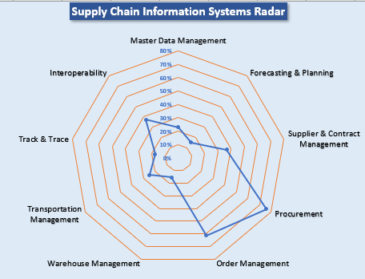
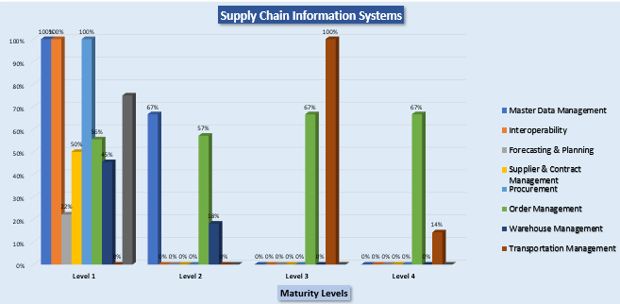
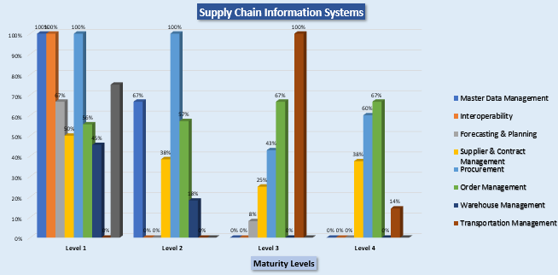
March 2019
Aug 2020

Slide 6
Our suggestions on Interoperability SCISMM Sheet
Level 1 | Level 2 | Level 3 | Level 4
Complete upload data report with option to upload or revert back | Configure dynamic Web services, APIs on data / database | Configurable consumers to consume third party Web Services, API, Etc. | Configurable Queues
Data loading logs for data security | Configure standard formats for interfacing / integration | Standard messages for third party system like 0- data loaded successfully, 1- Error loading data 2- Missing master data, etc. | Support Standard system Adopters for popular databases and systems
 | Data security by adding tokens / encryption | Log DB for reconciliation, Email / SMS alerts for admin | Time scheduling of interfacing
 |  | Data security by adding tokens / encryption | Data reconciliation module
 |  |  | Configurable alerts and notifications
 |  |  | Configure interface method: Sync / Async
 |  |  | Data security by adding tokens / encryption

Slide 7







Impact
LMIS (99.99% up time)
Reporting Points = Approx. 27K
Average transactions / month = Approx. 415K
Government and stakeholders’ staff have been trained = Approx. 10K plus
All data reported by Government staff in information systems; with data visibility, for last many years, 100% commodities are funded by Governments of Pakistan
Enhanced data visibility by interfacing with vertical programs like MNCH LMIS, MNCH LMIS and private sector (MERF, IHS , PPHI)
Amongst the few Information Systems of Pakistan, which is implemented across Pakistan despite devolution after 18th Amendment.
COVID-19 Supplies /GIS Map
Procurement &
Logistics
Family Planning Commodities
EPI Program Commodities
COVID-19 PO#
266 entries
Travelers Data
2.46K Flights, 204.43 Passengers
Medicines
Procurement
COVID-19 Supplies
EMR (Coming Soon)
~14,000 logistics transaction / day
35 million <5 children beneficiaries
33 million MWRA as beneficiaries
CYP = Approx. 11.69%
Un-averted pregnancies = Approx. 0.29
Un-intended births or abortions averted = Approx. 0.25
Infant Mortality rate = Approx. 0.064
200 Ventilators provided to governments of Pakistan, funded by USAID to save lives
KP D-Talk EMR (Insulin Program)
Services
Doctor’s Hub – GP EMR & POS
General Purpose Web based EMR with Lab, MDM modules
Notes:
Active Reporting Points CLMIS = 17,964 VLMIS = 8,988
Average Transactions Per Month CLMIS = 200,002 and VLMIS = 216,879

Slide 8
USAID GLOBAL HEALTH SUPPLY CHAIN PROGRAM
Procurement and Supply Management
National Science and Technology Park (NSTP)
NUST, H12, Islamabad, 44000, Pakistan
+92 333 5555 291
Questions/Comments
MTariq@Chemonics.com
Thank you

