Slide 1
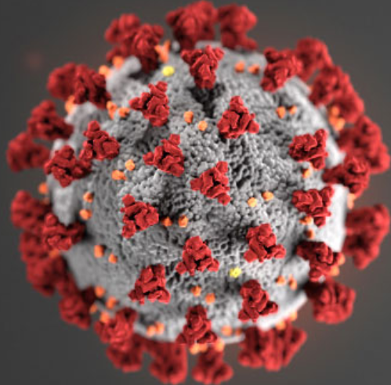

COVID-19 Supply Chain Job Aid
Description: Clinical presentation among reported cases of COVID-19 varies in severity from asymptomatic infection or mild illness to severe or fatal illness. Some reports suggest the potential for clinical deterioration during the second week of illness. Acute respiratory distress syndrome (ARDS) developed in 17–29% of hospitalized patients, and secondary infection developed in 10%. Among hospitalized patients with pneumonia, the case fatality proportion has been reported as 4–15%. No specific treatment for COVID-19 is currently available. COVID-19 is caused by infection with SARS-CoV-2 virus, which is a beta-coronavirus, like MERS-CoV and SARS-CoV. Frequently reported signs and symptoms include fever, cough, myalgia or fatigue, and shortness of breath at illness onset. Data from human infection with other coronaviruses (e.g. MERS-CoV, SARS-CoV) suggest that the incubation period may range from 2-14 days.
COVID-19
Mode of transmission: Based on current information it is assumed that COVID-19 is transmitted through respiratory droplets. Airborne and fecal-oral transmission are likely but the clinical significance in the context of an outbreak is unknown.
SUPPLY CHAIN CONSIDERATIONS
  Supply chain personnel should follow PPE protocols if they are entering treatment red zones or coming into contact with suspected cases
  Respiratory support is recommended for patients with severe respiratory distress
SUGGESTED COMMODITY LIST
DIAGNOSTICS
Oxygen concentrator
DISINFECTION CONSUMABLES/BIOHAZARDOUS WASTE MANAGEMENT
ELISA and RT PCR Laboratory equipment and reagents
Oxygen face mask with reservoir bag, disposable
Alcohol based hand-rub
HEALTH FACILITIES INFRASTRUCTURE AND EQUIPMENT
Pulse oximeter, portable
Bag, disposable for biohazardous waste PPE and clinical waste without sharps
Ambulance with air isolation system for transport of contagious patients
Sample collection tubes
Body bags (suitable for burial or cremation)
Swabs for buccal sample collection
Disinfectant
Mobile, basic diagnostic X-ray system
Swabs for nasal sample collection
Soap, surgical
Portable ultrasound
Syringes: 0.5 ml autodestruct (AD) and 5 ml reuse prevention (RUP)
Set: mask, gel and soap for targeted population
Resuscitator
Chlorine
Medical triage/treatment/isolation facilities
Infusion setup including pump
DRUGS AND MEDICAL CONSUMABLES
Packaging transport substance for viral sample transport
PERSONAL PROTECTIVE EQUIPMENT
Paracetamol
N95 respirators
Gloves
Oxygen
Surgical masks
Goggles
Infusion compound (Ringer's lactate)
Gown, disposable, with elastic wrists
Antibiotics (for secondary infections)
Ventilators with portable and back-up power supply
ADVANCED
MEDICAL EQUIPMENT
Medical mask
Home Care Kits for home isolation of asymptomatic cases or mildly symptomatic
Infrared thermometer
Eye/face shield
Antivirals/vaccines (under review/in development)
Laryngoscope, adult, child set
Safety box/sharps container (must be labelled "Biohazard")
Endotracheal tubes
Scrubs
SOURCE: Adapted from job aid for Respiratory/ Droplet-borne disease, supplemented with information from WHO Disease Commodity Package (Feb 7 2020), CDC Coronavirus (Feb 27, 2020) and McKinsey supply chain and infectious disease expert interviews

