Slide 1

Country X NSCA 2.0
NATIONAL SUPPLY CHAIN ASSESSMENT
Preliminary Findings
Month Day, Year
Capital City, Country X

Slide 2
Debrief Agenda
Introduction to NSCA 2.0
  Objectives & Process
  Timeline
  Outputs
Methodology
  NSCA 2.0 Basics & Enumerator Training
  Tracer Commodities
  Supply Chain Mapping
  Sites Visited
  Types of Data collected
    Capability Maturity Model
    Key Performance Indicators
Preliminary Findings
Challenges
Acknowledgments & Next Steps
Questions

Slide 3
Debrief Agenda continued (1)
Introduction to NSCA 2.0
  Objectives & Process
  Timeline
  Outputs
Methodology
  NSCA 2.0 Basics & Enumerator Training
  Tracer Commodities
  Supply Chain Mapping
  Sites Visited
  Types of Data collected
    Capability Maturity Model
    Key Performance Indicators
Preliminary Findings
Challenges
Acknowledgments & Next Steps
Questions

Slide 4
Objective of Country X’s NSCA 2.0 are to:
Provide a comprehensive view of Country X’s public sector pharmaceutical supply chain maturity and performance
Analyze and measure the performance of the Supply Chain
Use NSCA to further customize interventions at various facility levels
Identify focus areas of opportunity for MOH planning and stakeholder coordination to inform the development of transformational plan(s) to guide system strengthening investments

Slide 5
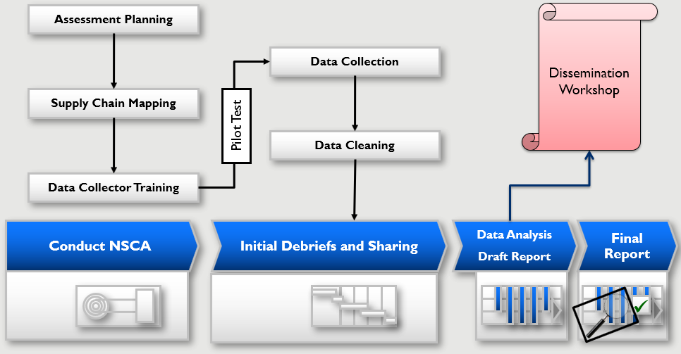
The National Supply Chain Assessment (NSCA) follows a structured and systematic process

Slide 6
Debrief Agenda continued (2)
Introduction to NSCA 2.0
  Objectives & Process
  Timeline
  Outputs
Methodology
  NSCA 2.0 Basics & Enumerator Training
  Tracer Commodities
  Supply Chain Mapping
  Sites Visited
  Types of Data collected
    Capability Maturity Model
    Key Performance Indicators
Preliminary Findings
Challenges
Acknowledgments & Next Steps
Questions

Slide 7
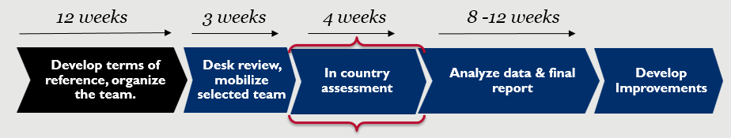
Country X NSCA Timeline
Indicative timeline to accomplish the NSCA
Week 1 – Data collectors training, supply chain mapping, and in-brief.
Week 2 – Data collection begins at all levels.
Week 3 – Data collection continues and concludes.
Week 4 – Out Brief (Month Day) on Preliminary Findings presented.
7
Notes:
This timeline is an example of Uganda’s timeline.

Slide 8
Debrief Agenda continued (3)
Introduction to NSCA 2.0
  Objectives & Process
  Timeline
  Outputs
Methodology
  NSCA 2.0 Basics & Enumerator Training
  Tracer Commodities
  Supply Chain Mapping
  Sites Visited
  Types of Data collected
    Capability Maturity Model
    Key Performance Indicators
Preliminary Findings
Challenges
Acknowledgments & Next Steps
Questions

Slide 9
Expected Outputs Of Country X’s NSCA 2.0
Partners work plans aligned to address gaps or bottlenecks
Documented current performance and shared best practices from site to site
Advocacy tool developed for further funding
Government of Country X and stakeholder investments identified for public health supply chain improvements
Strategic plan developed with regard to Policy X and Name of Strategic Plan Y

Slide 10
Debrief Agenda continued (4)
Introduction to NSCA 2.0
  Objectives & Process
  Timeline
  Outputs
Methodology
  NSCA 2.0 Basics & Enumerator Training
  Tracer Commodities
  Supply Chain Mapping
  Sites Visited
  Types of Data collected
    Capability Maturity Model
    Key Performance Indicators
Preliminary Findings
Challenges
Acknowledgments & Next Steps
Questions

Slide 11
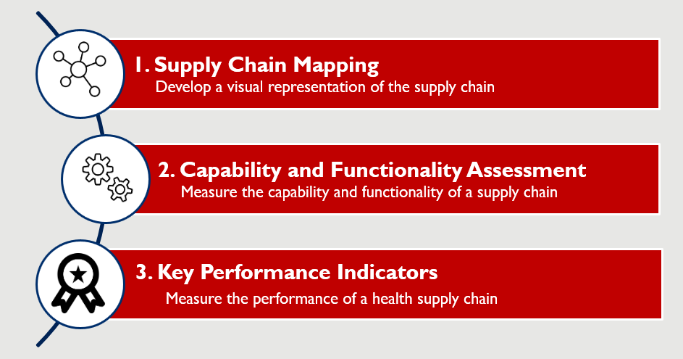
Components of the NSCA 2.0

Slide 12
Definitions of Level of Maturity and Contribution to the Overall CMM Score
Level of Maturity (Contribution) | Definition | Inventory Example
Basic (50%) | Must have capabilities and resources | Stock Cards
Intermediate (30%) | Important, but not must-have | An excel sheet
Advanced (15%) | Nice-to-have | A dispensing and stock management electronic tool
State of Art (SOA) (5%) | As deployed by leading global logistics orgs. | An ERP system for stock
Notes:
This could be converted to a more effective Graphic
Important points-
Overview of scoring- what are the four categories and why is scoring important
what makes this version so effective -Not just a single categorization –
May want to compare with other maturity models
Two different ways to reach an overall “basic” score
All basic capabilities
Mix of basic w/some gaps and some intermediate
Important internal note- - What to call below basic – Where and when to set expectations
More detail on maturity model to be included in training as additional slides
Discuss different ways of looking at maturity scores.
Overall level
What score is sufficiently basic
Variability between sites
No bright lines-…
Situation where could be gaps in basic maturity and some advanced capabilities in the same function

Slide 13
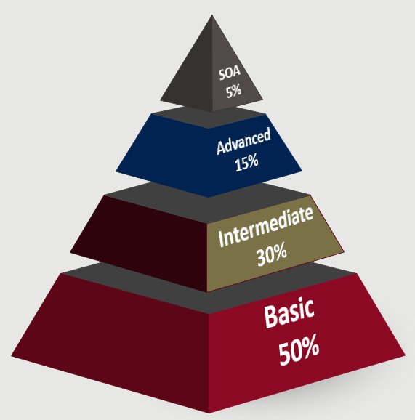
Overall Capability Maturity Model Score
Each question is scored
Sum of individual scores at each maturity level is the max for that level
Sum of all scores creates a total score for that module
It is possible to have a mix of basic and higher maturity capabilities

Slide 14
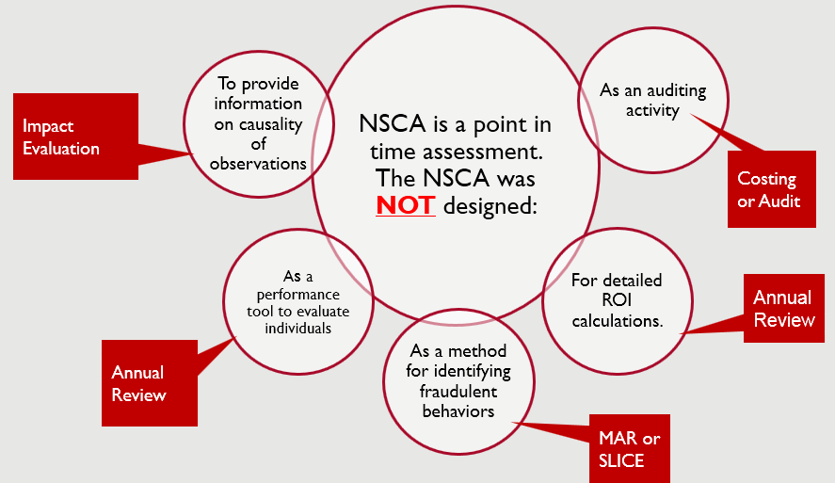
What NSCA is not
NSCA 2.0 does not fulfill all supply chain evaluation needs- it may intersect with, but cannot replace, other resources
14

Slide 15

What the NSCA Can do:
NSCA can describe performance (in terms of KPIs) and the capability maturity of a supply chain.
Depending on the sample size, detailed analysis can show correlation, but not causation.
  The CMM can help to isolate the inputs and processes that are commonly present or absent at different levels of the supply chain.
CMM findings are therefore likely to identify areas where investments or actions can lead to improved performance.

Slide 16
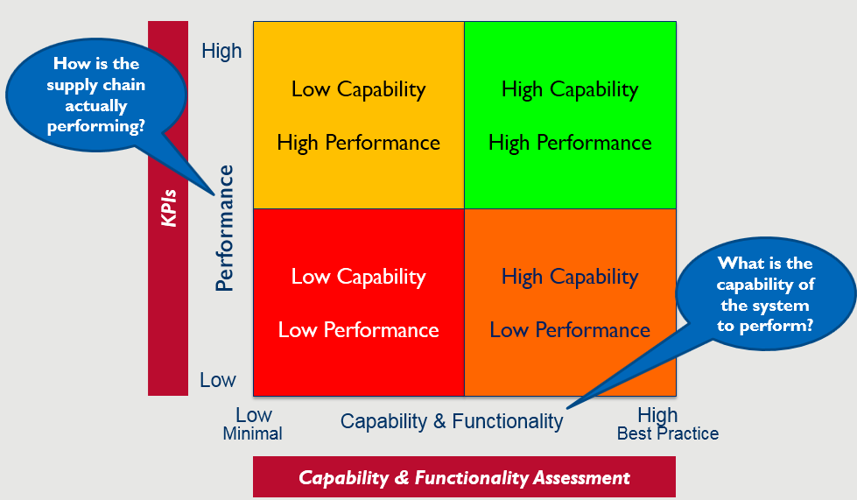
The Tools Evaluate Supply Chain Capability, Functionality And Performance
16
Notes:
Understanding capability and performance provides a complete picture of a supply chain’s current state. Although theoretically highly developed capability should lead to higher-levels of performance (and vice versa), this is not necessarily the case. The National Supply Chain Assessment provides data on both better informing planning and performance management.

Slide 17
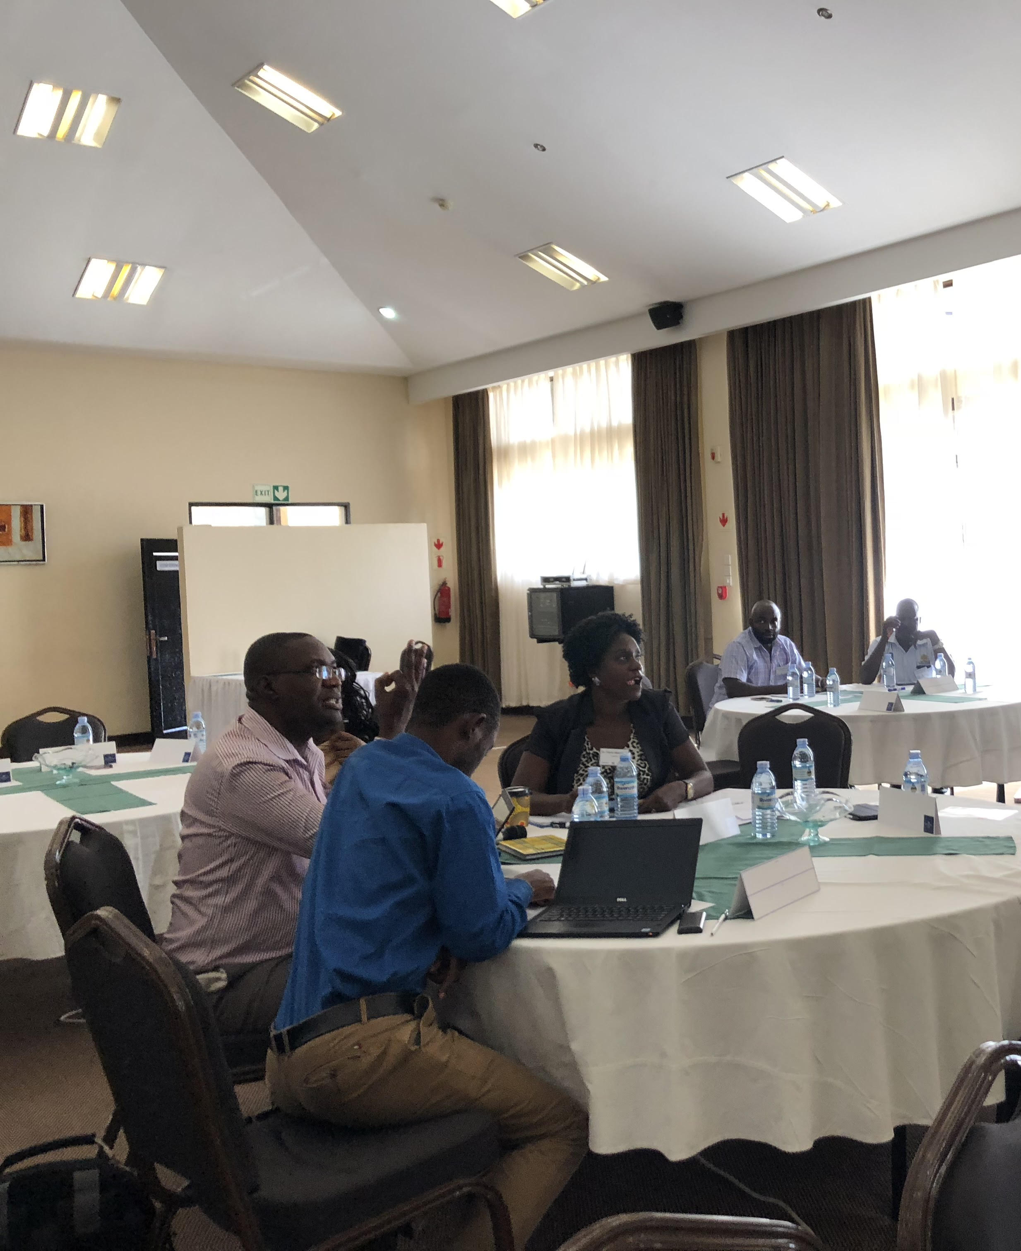
About the Data Collectors
Data collectors included X titles and Y health workers/pharmacists currently working in Country X’s health system
Data collectors participated in a 4 day training preceding the assessment
Training included:
  In-depth examination of the NSCA tool and objectives
  Data collection process and best practices
  Interview tips
  Tool pilot testing

Slide 18
Debrief Agenda continued (5)
Introduction to NSCA 2.0
  Objectives & Process
  Timeline
  Outputs
Methodology
  NSCA 2.0 Basics & Enumerator Training
  Tracer Commodities
  Supply Chain Mapping
  Sites Visited
  Types of Data collected
    Capability Maturity Model
    Key Performance Indicators
Preliminary Findings
Challenges
Acknowledgments & Next Steps
Questions

Slide 19
Country X NSCA 2.0 Tracer Commodities
Tracer Commodities | Associated Program | Unit of Measure | Special Handling
Tenofovir/Lamivudine/Efavirenz 600/300/300 | HIV | Bottle of 30 tabs | None
Male Condoms | RMNCAH | Condom | None
Malaria RDTs | Malaria & Lab | Test, normally in packs of 25 | None
Long-lasting Insecticidal Nets | Malaria | Single LLIN | None
Rifampicin/INH/Pyrazinamide/Ethambutol 150/75/400/275 mg | TB | Bottle of 500 | Cool, dry place, less than 25C
Depot Medroxyprogesterone Acetate Intra-muscular | RMNCAH & Family Health | Vial | 20-25C - Cool storage, vials must be up-right
ORS + Zinc | RMNCAH | Sachet | None
Tetanus Toxoid | VMMC and RMNCAH | Vial | Cold storage 2-8C
Oxytocin International Units | RMNCAH | Vial | Cold storage 2-8C
ACTs (AL) 6x4 | EMHS & Malaria | Packet | None
Amoxicillin 250mg Capsule | EMHS | Bottle of 1000 capsules | None
Metformin 500mg tablets | EMHS & NCD | Bottle of 100 tablets | Cold storage
Determine HIV RTK | HIV | Test normally in packs of 100 | None
19

Slide 20
Debrief Agenda continued (6)
Introduction to NSCA 2.0
  Objectives & Process
  Timeline
  Outputs
Methodology
  NSCA 2.0 Basics & Enumerator Training
  Tracer Commodities
  Supply Chain Mapping
  Sites Visited
  Types of Data collected
    Capability Maturity Model
    Key Performance Indicators
Preliminary Findings
Challenges
Acknowledgments & Next Steps
Questions

Slide 21
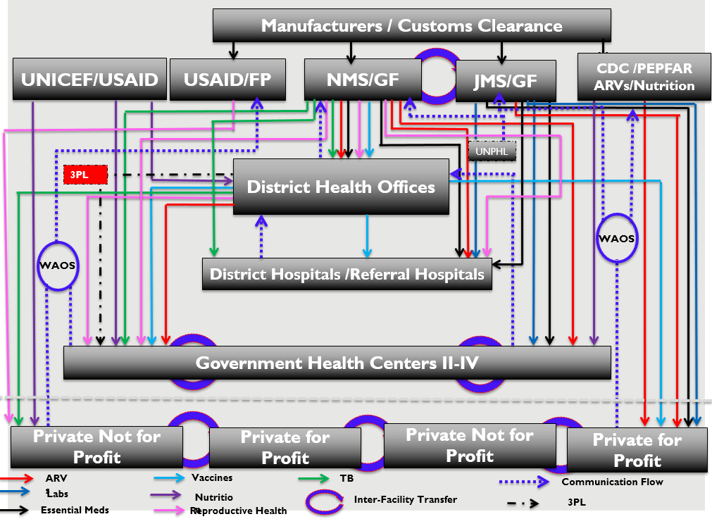
Uganda National Health Supply Chain Product and Information Flow
Notes:
Lab = orange
TB = Green
Essential Meds = Black
HIV/AIDS= Red
Nutrition = Purple
Blue = vaccines
Pink = reproductive health
**Specialized lab commodities are delivered directly by JMS and cross docked through UNPHL

Slide 22
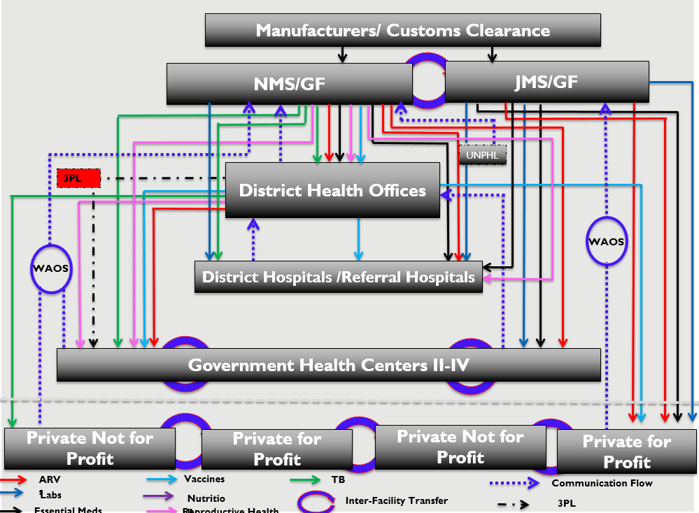
NSCA Map of Public Funded Facilities in Uganda
Notes:
Lab = orange
TB = Green
Essential Meds = Black
HIV/AIDS= Red
Nutrition = Purple
Blue = vaccines
Pink = reproductive health
**Specialized lab commodities are delivered directly by JMS and cross docked through UNPHL

Slide 23
Debrief Agenda continued (7)
Introduction to NSCA 2.0
  Objectives & Process
  Timeline
  Outputs
Methodology
  NSCA 2.0 Basics & Enumerator Training
  Tracer Commodities
  Supply Chain Mapping
  Sites Visited
  Types of Data collected
    Capability Maturity Model
    Key Performance Indicators
Preliminary Findings
Challenges
Acknowledgments & Next Steps
Questions

Slide 24

Central Level Interviews
24

Slide 25


Sampling goal
Decrease bias
Increase representativeness
25

Slide 26
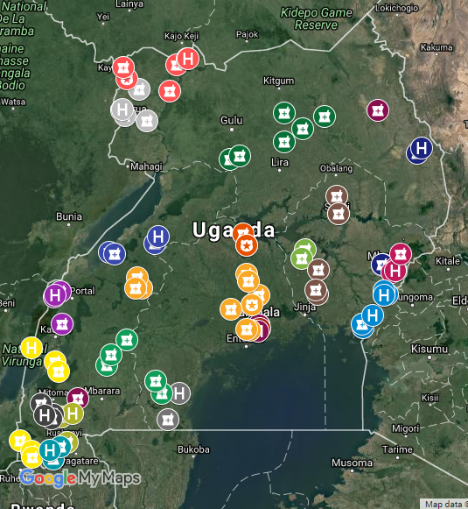
Districts, followed by the sites within districts, were randomly selected
Random selection is required to reduce bias and increase representativeness
Sites | #
Central Warehouse | 2
Health Center II | 31
Health Center III | 31
Health Center IV | 22
Hospitals | 17
MoH or similar institution | 3
DHOs/DVS | 31
Regional Referral Hospital | 8
A total of 145 Sites from 31 Districts
Notes:
National representative sample carrying full list of tracer commodities
Islands and inaccessible regions excluded
Over representation of Regional Referral Hospitals
PNFP Sites not included
26

Slide 27
Debrief Agenda continued (8)
Introduction to NSCA 2.0
  Objectives & Process
  Timeline
  Outputs
Methodology
  NSCA 2.0 Basics & Enumerator Training
  Tracer Commodities
  Supply Chain Mapping
  Sites Visited
  Types of Data collected
    Capability Maturity Model
    Key Performance Indicators
Preliminary Findings
Challenges
Acknowledgments & Next Steps
Questions

Slide 28
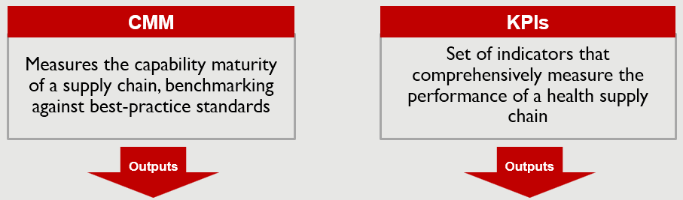
Using the NSCA 2.0 we collected data across all areas of the supply chain
Identifying areas of possible intervention
Approximate measure of performance against KPIs
Estimation of system capability
Overall quantitative, qualitative view of the supply chain
28

Slide 29
Debrief Agenda continued (9)
Introduction to NSCA 2.0
  Objectives & Process
  Timeline
  Outputs
Methodology
  NSCA 2.0 Basics & Enumerator Training
  Tracer Commodities
  Supply Chain Mapping
  Sites Visited
  Types of Data collected
    Capability Maturity Model
    Key Performance Indicators
Preliminary Findings
Challenges
Acknowledgments & Next Steps
Questions

Slide 30
Key Performance Indicators in Country X NSCA
Category | KPIs | KPIs
Forecasting | Forecast accuracy Source of funds | Supply plan accuracy
Procurement | Vendor on-time and in full delivery rate Percent of international reference price paid | Number of emergency orders placed on vendors, as a % of total orders placed Supplier fill rate Procurement methods employed Percentage of product selection based on NEML
Warehousing and inventory management | Stocked according to plan Stockout rate by tracer commodity by level in the system Stock accuracy Order fill rate Wastage from damage, theft and expiry | Number and duration of temperature excursions in cold storage facility Stockout rate of one or more tracer Commodities by facility Cost of warehousing operation
Distribution | On-time delivery to facility Percentage of orders placed by health facilities as emergency orders | Cost of distribution operation
HR | Staff turnover rate | Percent of key positions vacant
Data and information | Facility reporting rates on time | Facility reporting rates (complete)
30

Slide 31
Debrief Agenda continued (10)
Introduction to NSCA 2.0
  Objectives & Process
  Timeline
  Outputs
Methodology
  NSCA 2.0 Basics & Enumerator Training
  Tracer Commodities
  Supply Chain Mapping
  Sites Visited
  Types of Data collected
    Capability Maturity Model
    Key Performance Indicators
Preliminary Findings
Challenges
Acknowledgments & Next Steps
Questions

Slide 32
The CMM Heat Map presents modules capability across all tiers of the supply chain

Slide 33
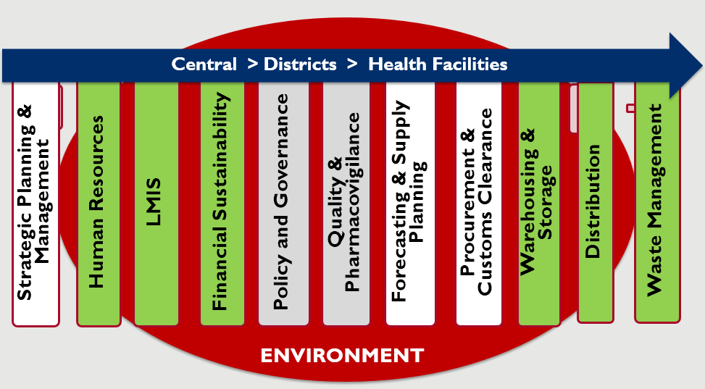
Our CMM focus today is based on the green tabs below

Slide 34
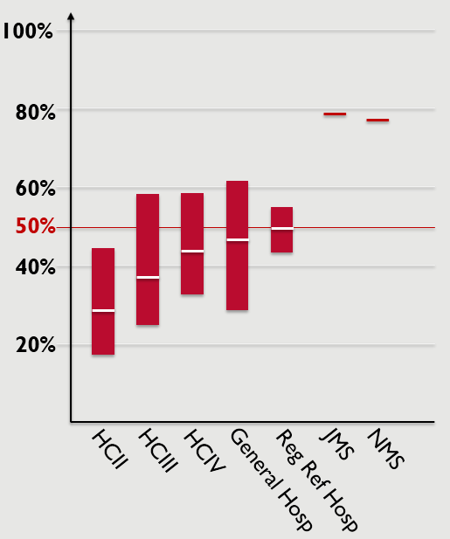
CMM Warehousing and Storage
KEY FINDINGS
Wide range of scores among health centres, general and regional referral hospitals
Increasing trend in average scores at SDPs
High scores for JMS and NMS

Slide 35
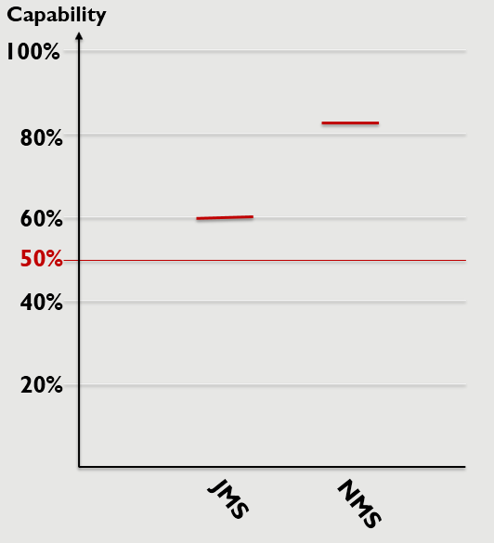
CMM Distribution
KEY FINDINGS
High score at the NMS (82%)
Moderate score at the JMS (60%)
35

Slide 36
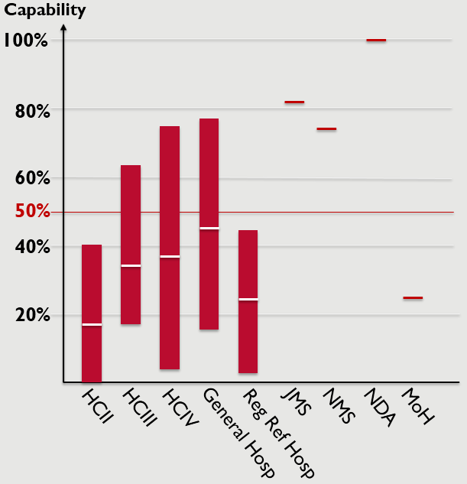
CMM Waste Management
KEY FINDINGS
Wide range in scores at health centers, general and regional referral hospitals
Increasing trend in average scores at higher level health facilities
High scores at JMS and NMS
36

Slide 37
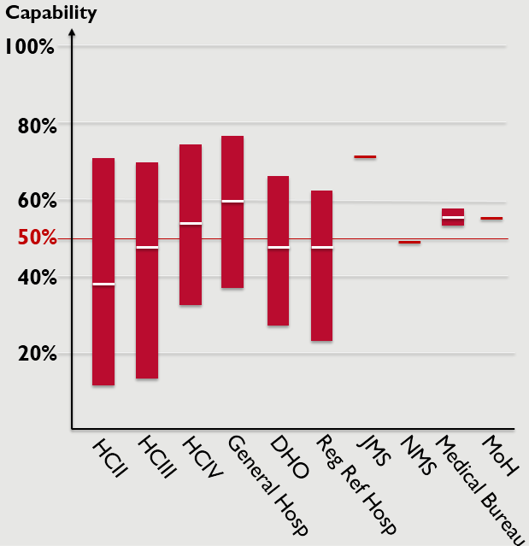
CMM Human Resources
KEY FINDINGS
Scored at all levels of supply chain
Wide range of scores at all levels
Increasing trend in average scores at higher level health facilities
Significant difference in score between NMS and JMS
37

Slide 38
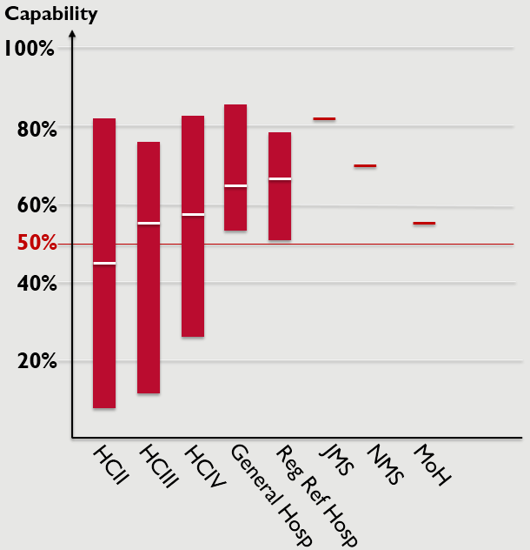
CMM Financial Sustainability
KEY FINDINGS
Wide range of scores at health Centres
Increasing trend in average scores at higher level health facilities
Higher scores at NMS and JMS
38

Slide 39
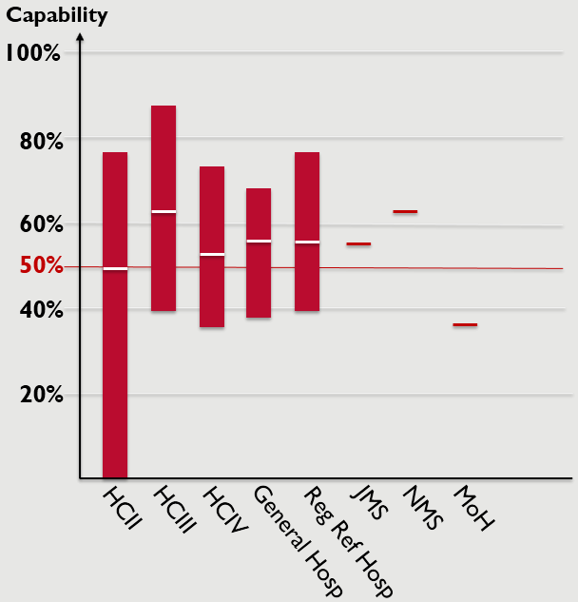
CMM LMIS
KEY FINDINGS
Wide range of scores at health centres, general and regional referral hospitals
Widest range of score at HCII (0% - 78%)
Average scores for SDPs in the mid fifties
Relatively similar scores for NMS and JMS
39

Slide 40
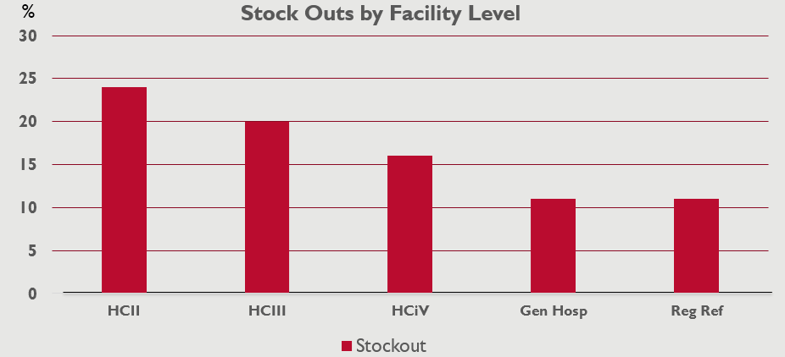
Stockouts are less prevalent across tracer commodities at the central levels with stock to plan between 21% & 26%
Note - Stockouts were on day of assessment
& those facilities not stocked to plan may be higher or low than plan
40

Slide 41
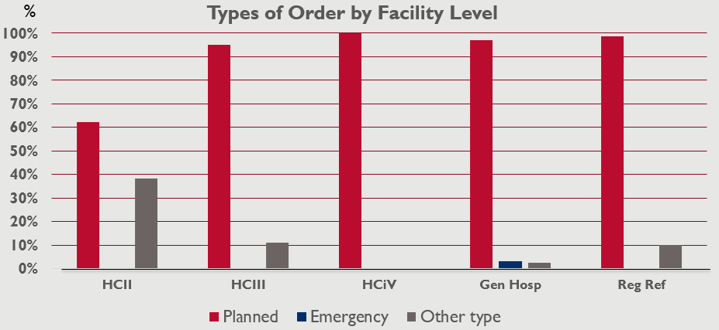
Why are Emergency Orders not being raised if a Stockout exists at a facility
41

Slide 42
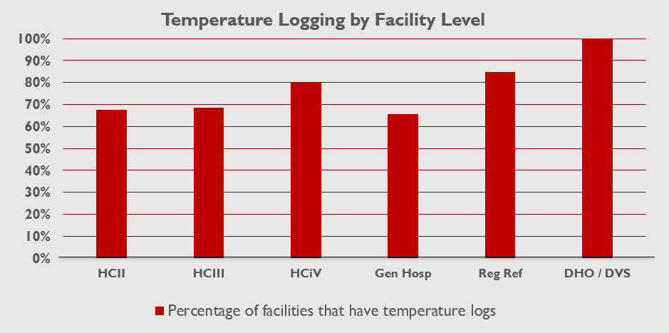
Many facilities at the lower levels do not have temperature logs
42

Slide 43
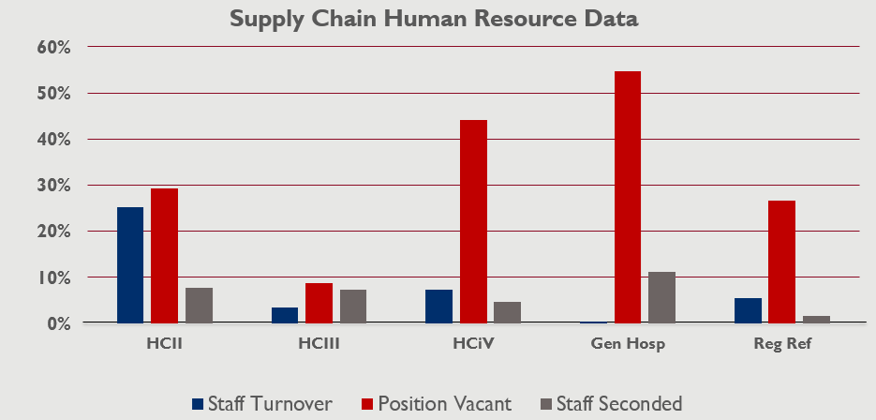
Supply chain staff turnover and positions vacant are high at the HCIIs and a high number vacancies exist at the hospitals
Note – Staff Turnover is over a period of one year 2017 - 2018
43

Slide 44
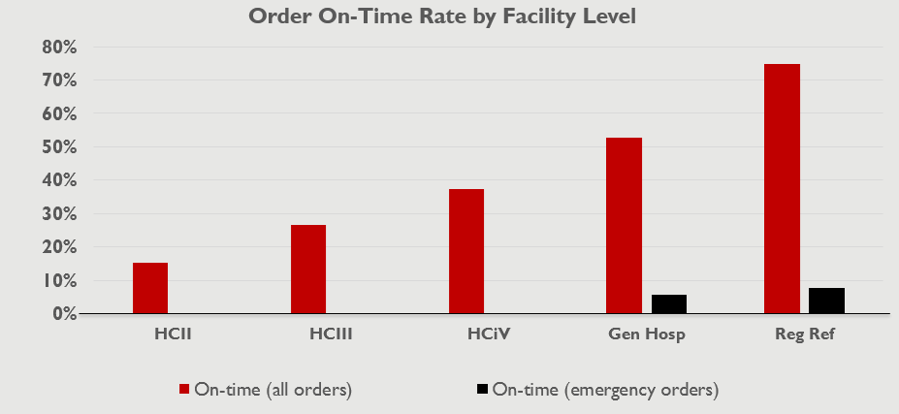
There is a significant decrease in Order On-Time Rate across tracer commodities at the lower levels
44

Slide 45
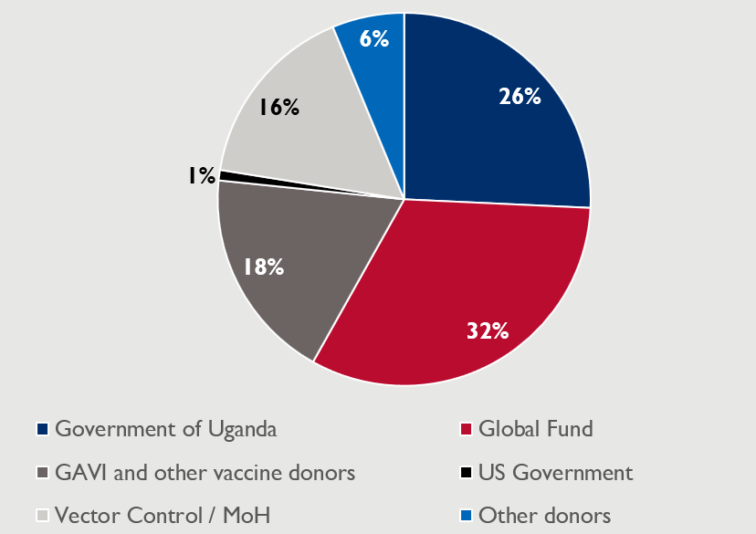
NMS Source of Funding FY16
45

Slide 46
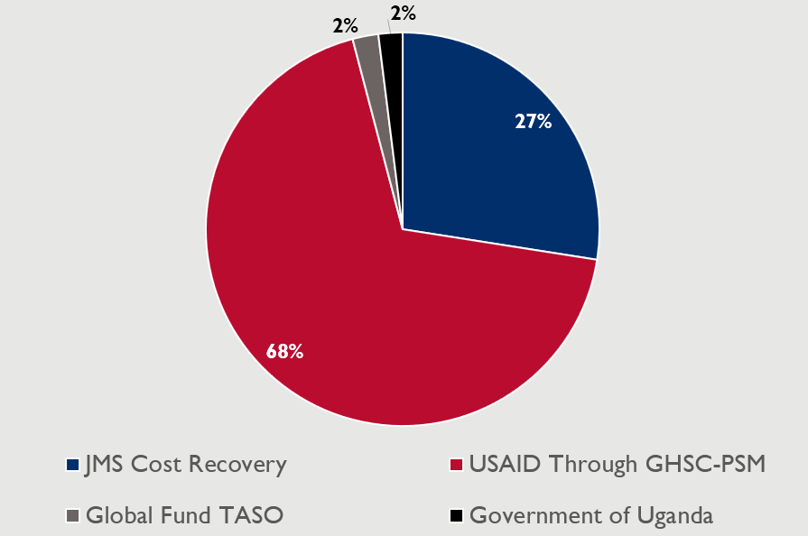
JMS Source of Funding
46

Slide 47
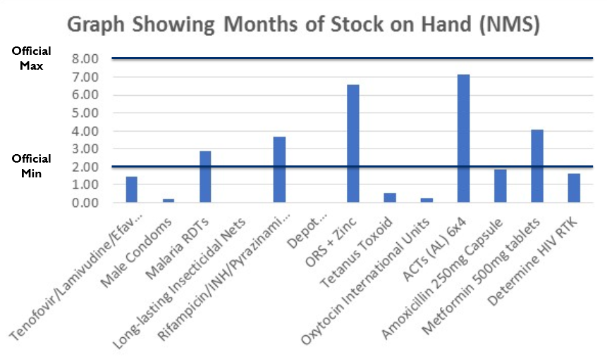
Less than 50% of tracer product stock holding is within the NMS Min / Max limits
Question: Is the Min set too low and Max set too high?

Slide 48
High-Level Findings and Observations
Supply chain strategy, governance and policy development is the mandate of MoH or higher level entity
Reporting, ordering and receiving processes are not automated at the health center level
  ARVs are the only exception
Gov’t allocations and cost recovery are insufficient for health commodity procurement.
  Often funding availability guides purchase of commodities, and budget for supply chain functions is non-existent at some facilities
Data shows high stock out rates on day of visit, but fewer emergency orders
Cold chain-temperature logs are not available at some facilities and limited information is documented about excursions
Limited availability of human resources with specialization in supply chain functions

Slide 49
Debrief Agenda continued (11)
Introduction to NSCA 2.0
  Objectives & Process
  Timeline
  Outputs
Methodology
  NSCA 2.0 Basics & Enumerator Training
  Tracer Commodities
  Supply Chain Mapping
  Sites Visited
  Types of Data collected
    Capability Maturity Model
    Key Performance Indicators
Preliminary Findings
Challenges
Acknowledgments & Next Steps
Questions

Slide 50
There were many challenges the enumerators encountered during data collection
Data collectors not given permission to interview key personnel
Key personnel not available to interview on the day of the visit
Health facility inaccessible due to road conditions (e.g., flood)
Vehicle breakdown
Health facility did not exist
50

Slide 51

There were many challenges which were overcome
51

Slide 52
Debrief Agenda continued (12)
Introduction to NSCA 2.0
  Objectives & Process
  Timeline
  Outputs
Methodology
  NSCA 2.0 Basics & Enumerator Training
  Tracer Commodities
  Supply Chain Mapping
  Sites Visited
  Types of Data collected
    Capability Maturity Model
    Key Performance Indicators
Preliminary Findings
Challenges
Acknowledgments & Next Steps
Questions

Slide 53
Further analysis will continue to recommend areas for root cause analysis and improvement planning
Data Collection & Analysis | Root Cause Deep Dives | Improvement Planning
NSCA-Assessment of the Supply Chain Capability and performance - Map supply chain, stakeholders - Measure capability, Performance - Identify bottle necks | Analysis / Diagnostic - Root causes and deep dive - Change history and past interventions - Align with Inter-ministerial Health committee | Health supply chain strengthening road map - Inform country strategic planning - Inform SC country and donors investment decision - Work around Low hanging areas and quick fixes

Slide 54

A BIG thank you to our Enumerators

Slide 55

A SPECIAL thank you to:
55

Slide 56
Next Steps/Deliverables
Completion of data collection
May 2018
Completion of in depth data analysis
August 2018
Draft Final Report competed
September 2018
Final Report
Dependent Upon Stakeholder Comments
Dissemination Workshop with Key Stakeholders to Present Final Report and Strategic Implementation Plan
Dependent Upon Stakeholder Comments
NB – deliverable timeline above is tentative and subject to wider consultations with relevant stakeholder.
56

Slide 57
Debrief Agenda continued (13)
Introduction to NSCA 2.0
  Objectives & Process
  Timeline
  Outputs
Methodology
  NSCA 2.0 Basics & Enumerator Training
  Tracer Commodities
  Supply Chain Mapping
  Sites Visited
  Types of Data collected
    Capability Maturity Model
    Key Performance Indicators
Preliminary Findings
Challenges
Acknowledgments & Next Steps
Questions

Slide 58

Any Questions

Slide 59

Thank You

